Slide 1
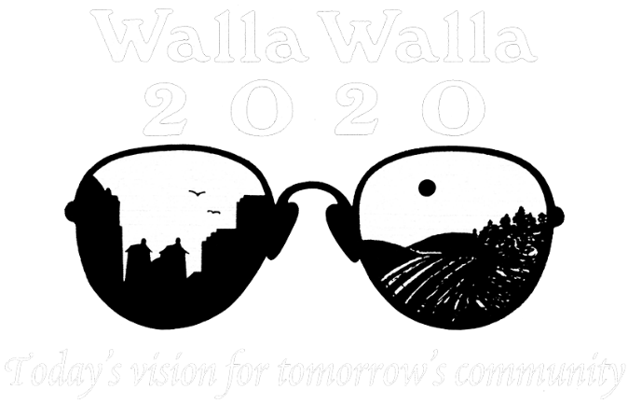
Awards
for a
Decade
Welcome!
April 27, 2015

Slide 2
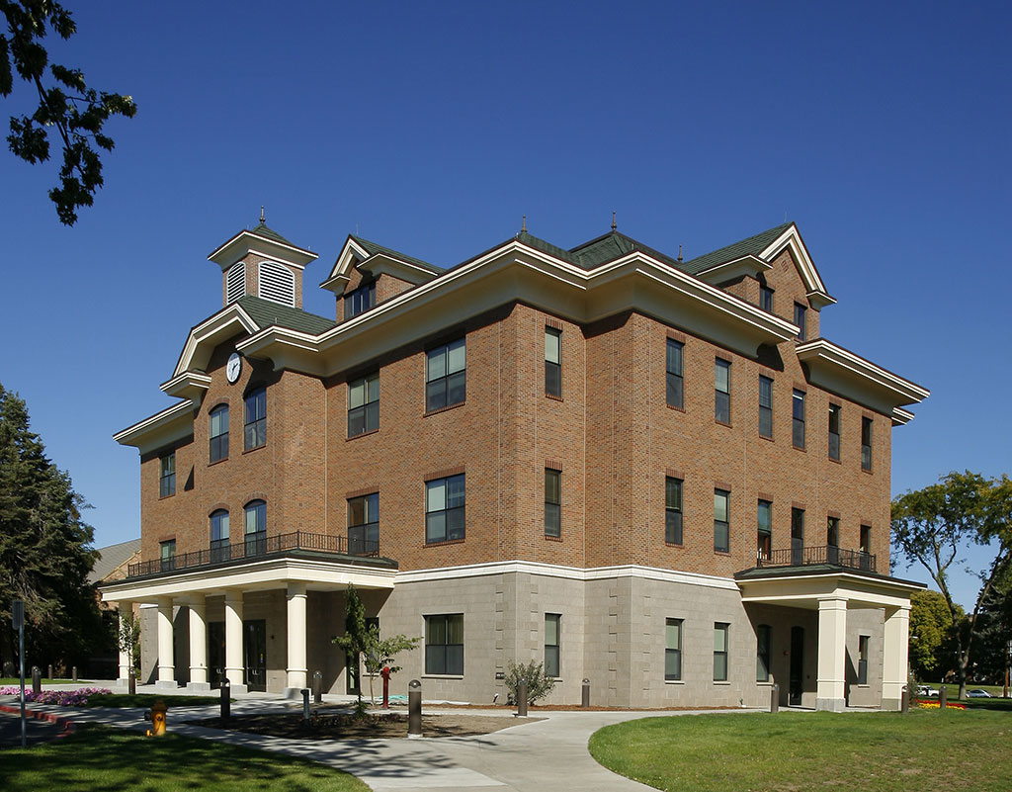
Walla Walla
University Administration
Building
Owner:
Walla Walla University
John McVay, President
Architect:
Salmon Bay Design Group
Contractor:
Leone & Keeble, Inc.

Slide 3
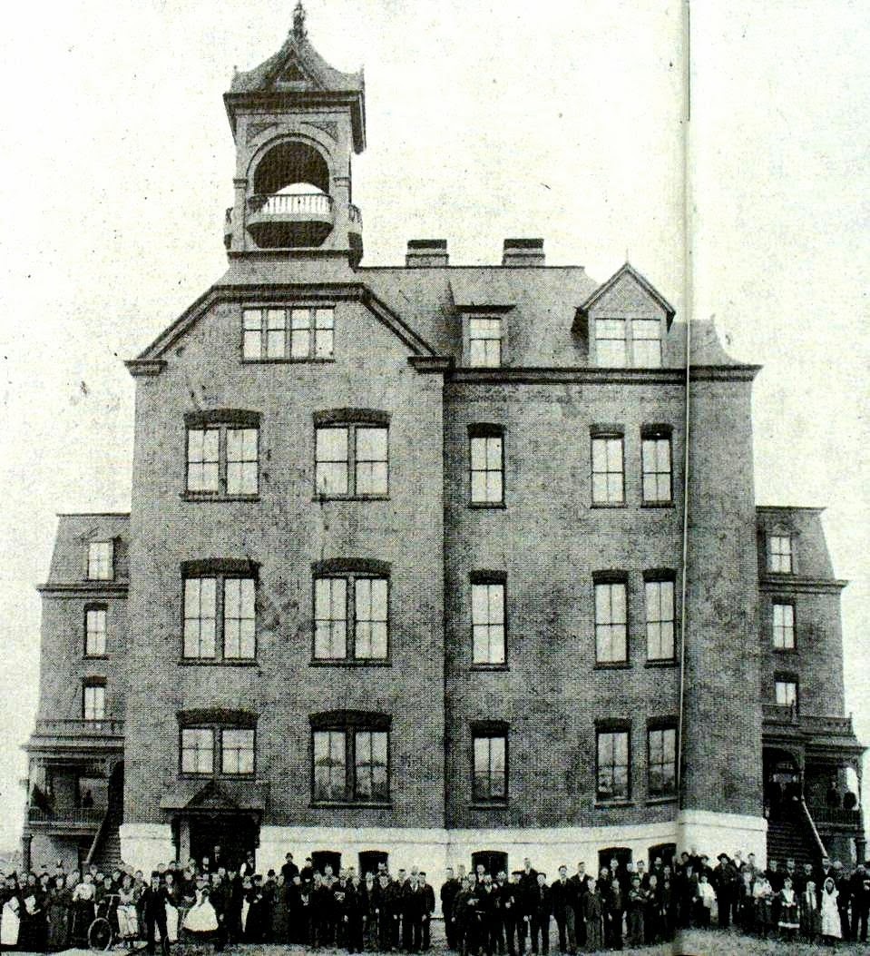
Original 1892 building; photo
circa 1918

Slide 4
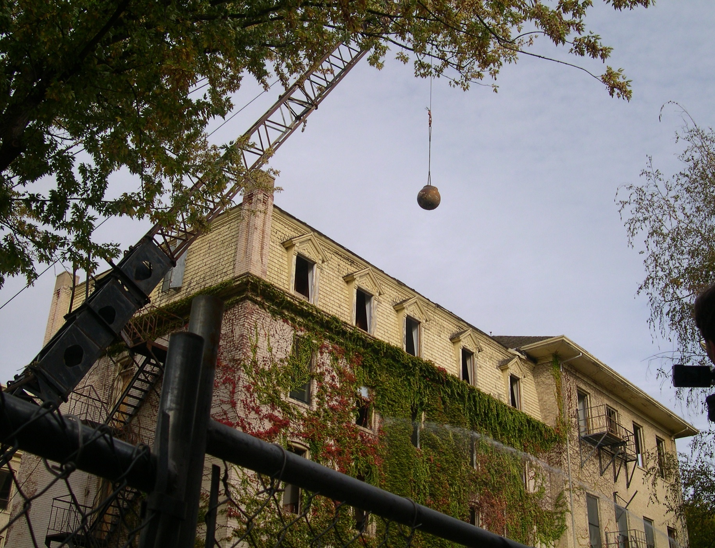

Slide 5
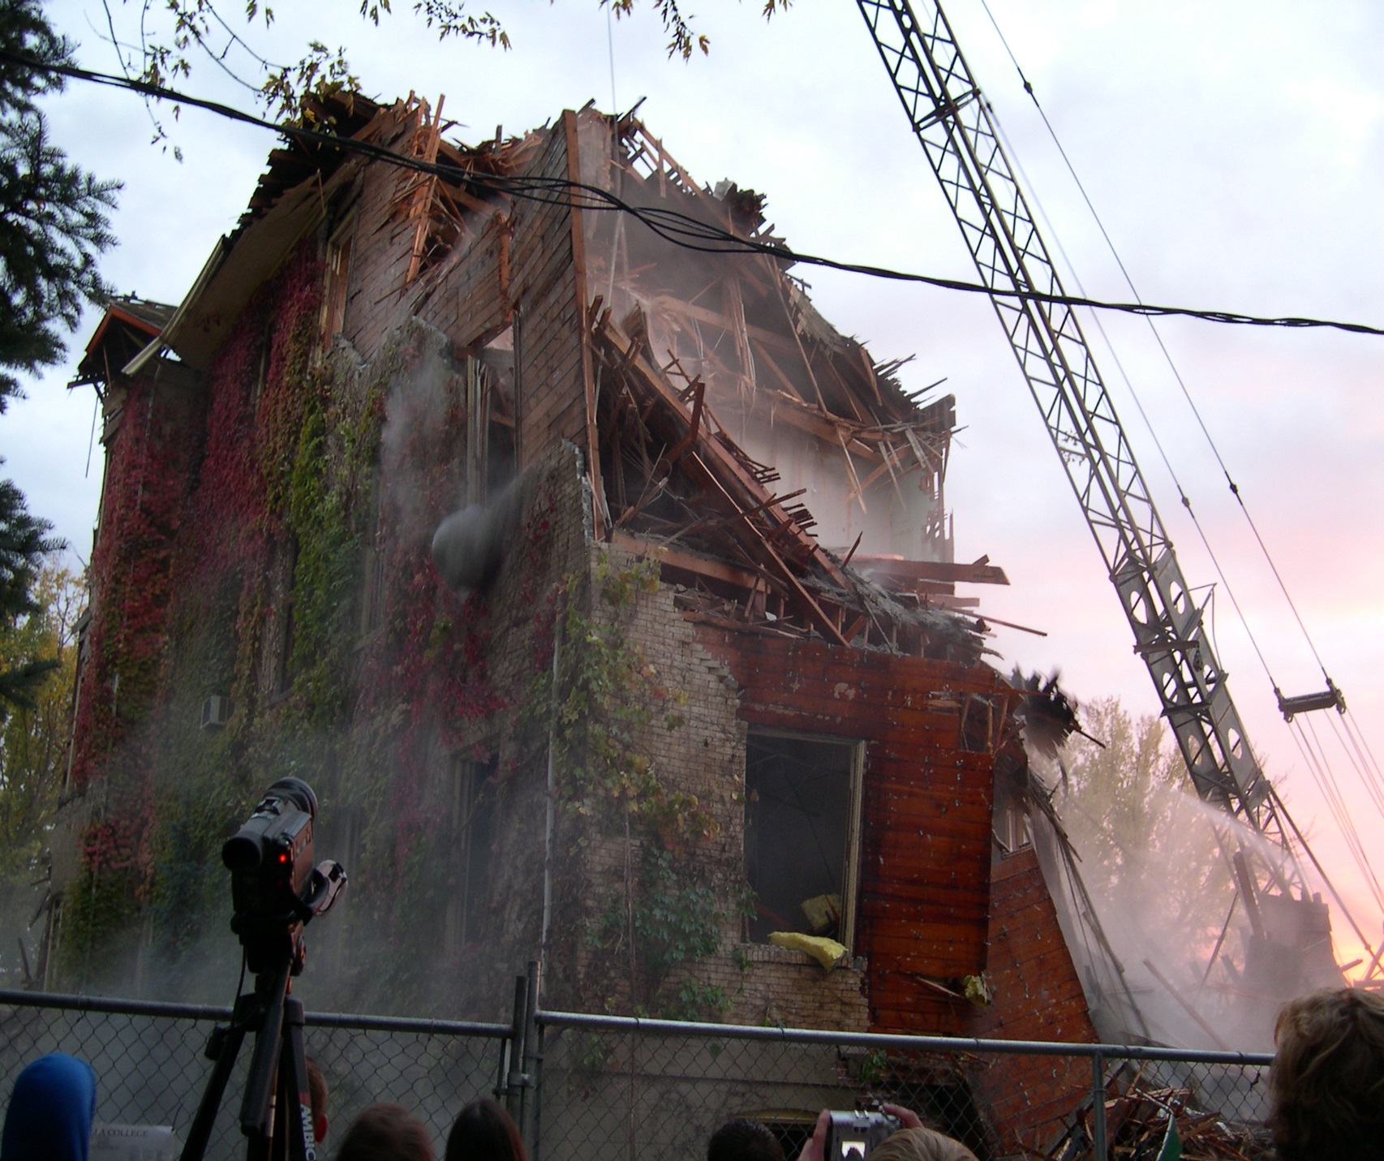

Slide 7
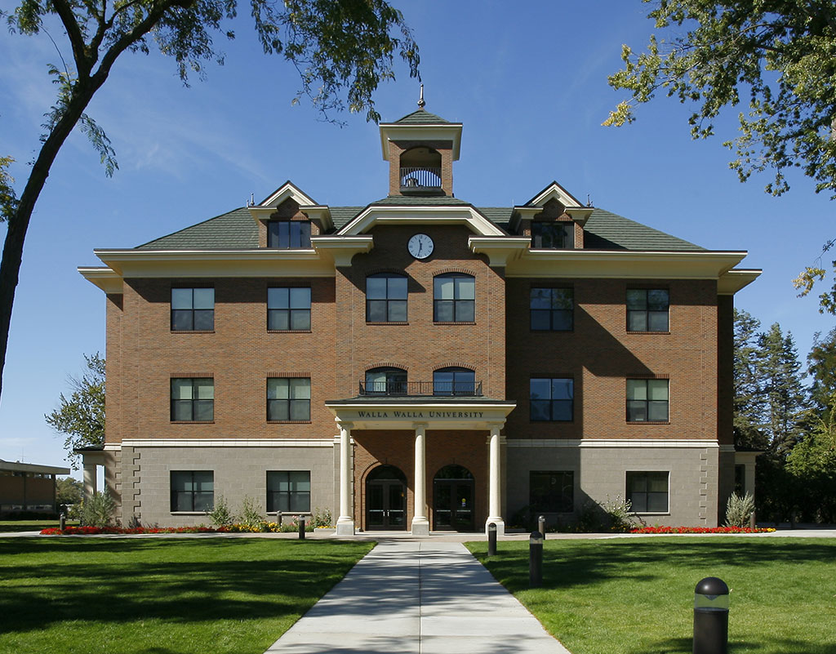

Slide 8
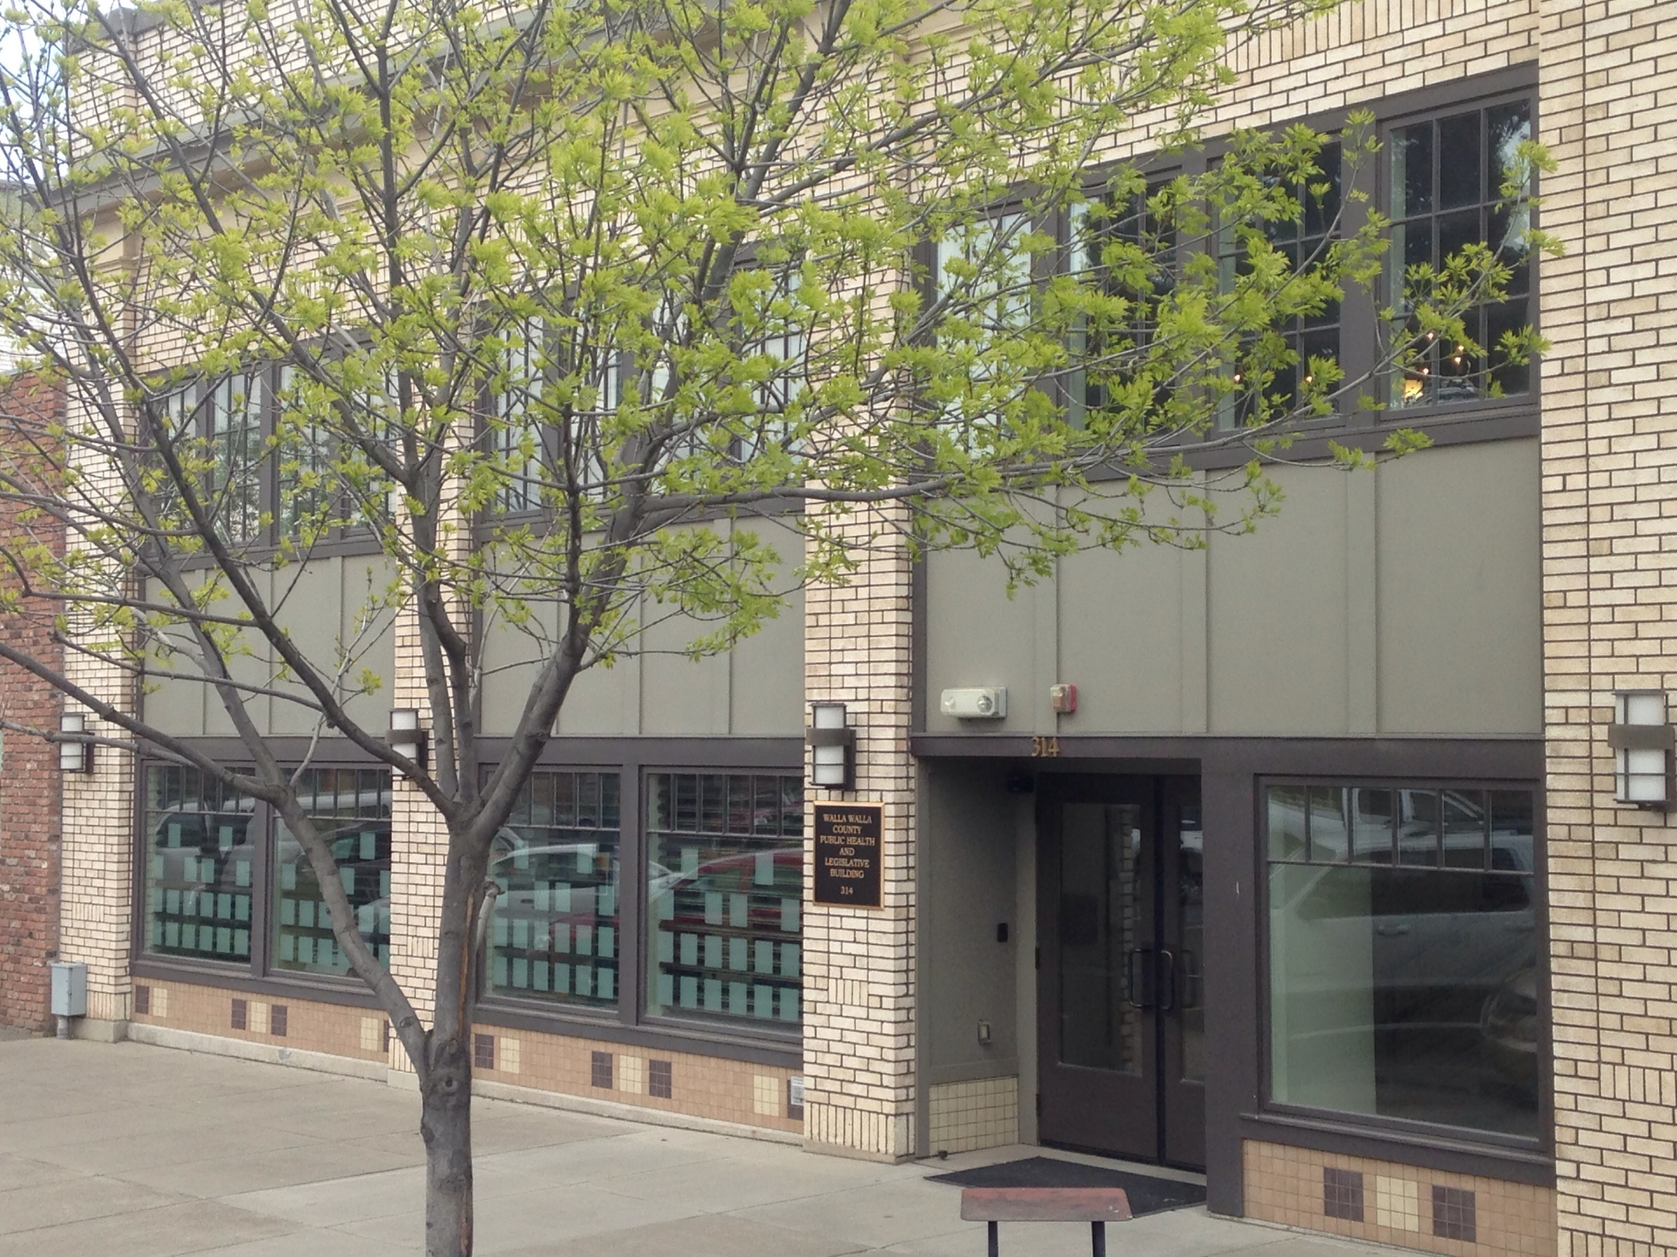
Walla Walla
County
Legislative
Building
Owner:
Walla Walla County
Architect:
Buffalo Design
Contractor:
Opp & Seibold
Project Manager:
Rob Robinson

Slide 9
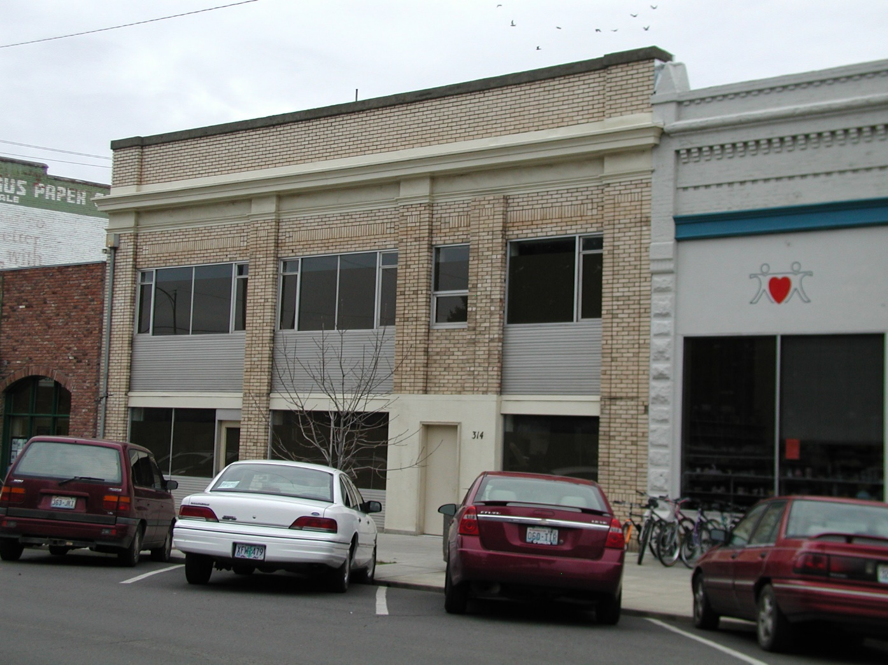

Slide 10
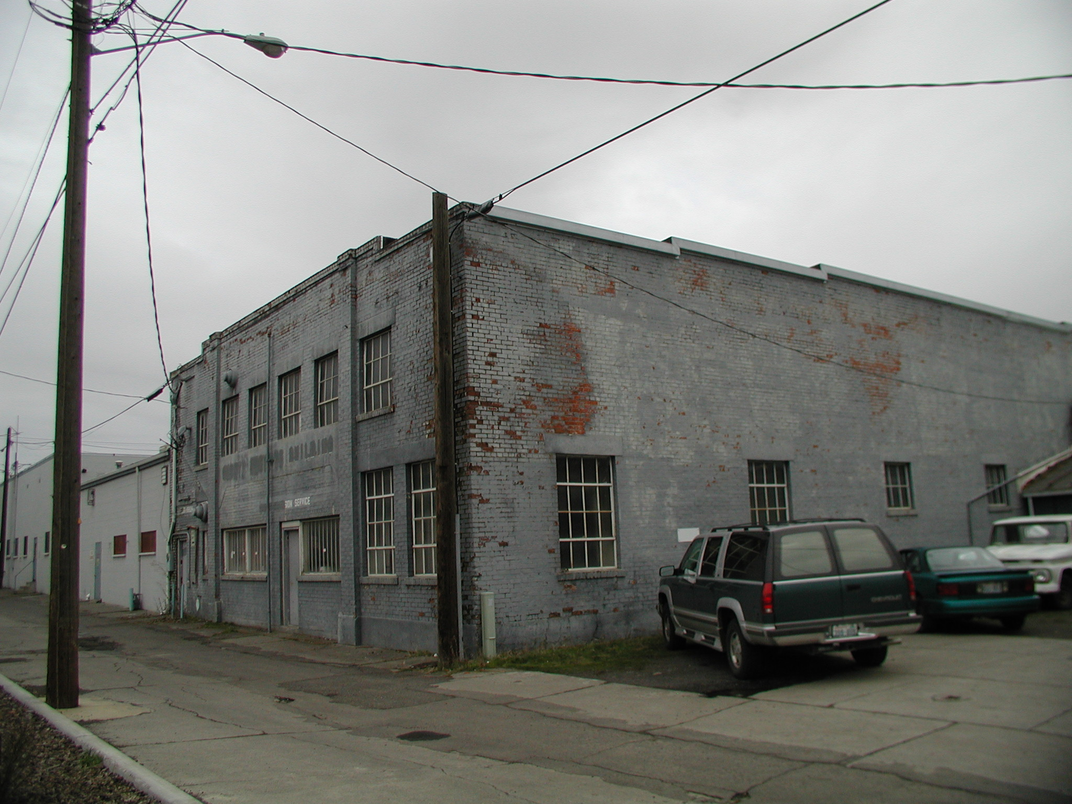

Slide 11
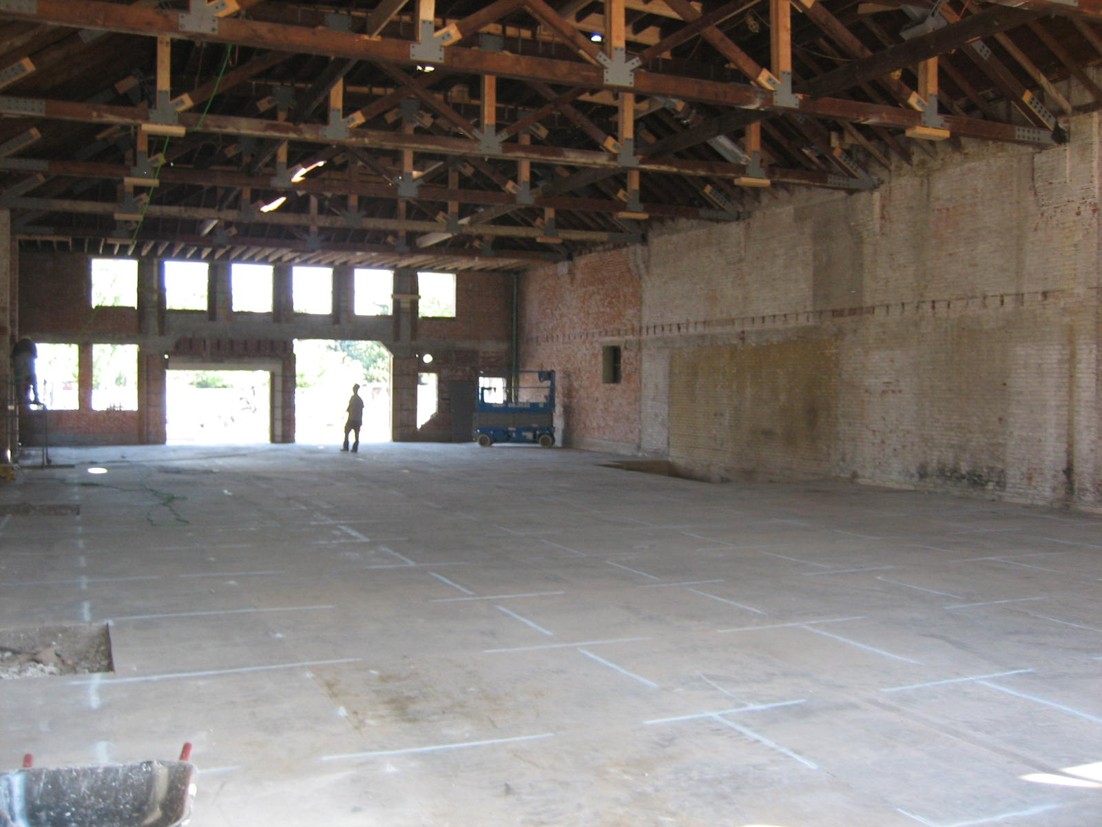

Slide 12
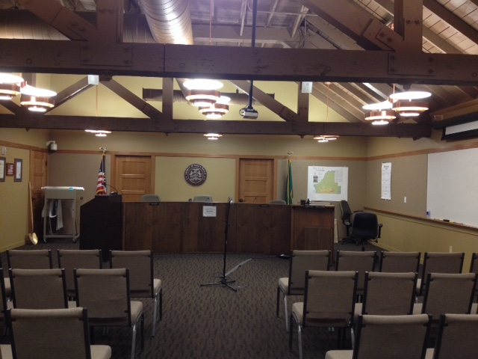

Slide 13
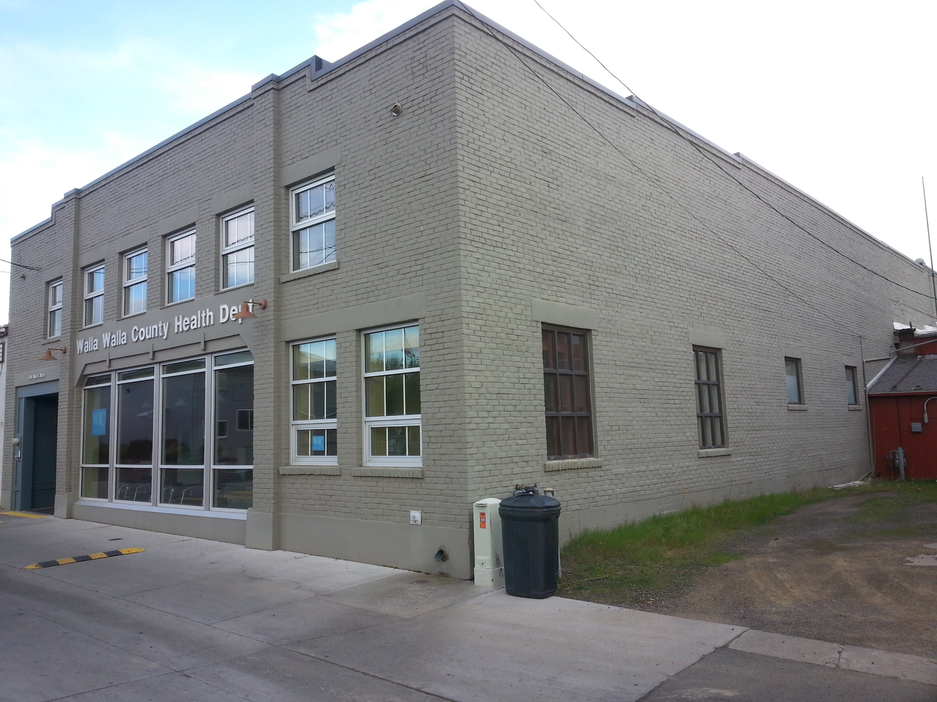

Slide 14
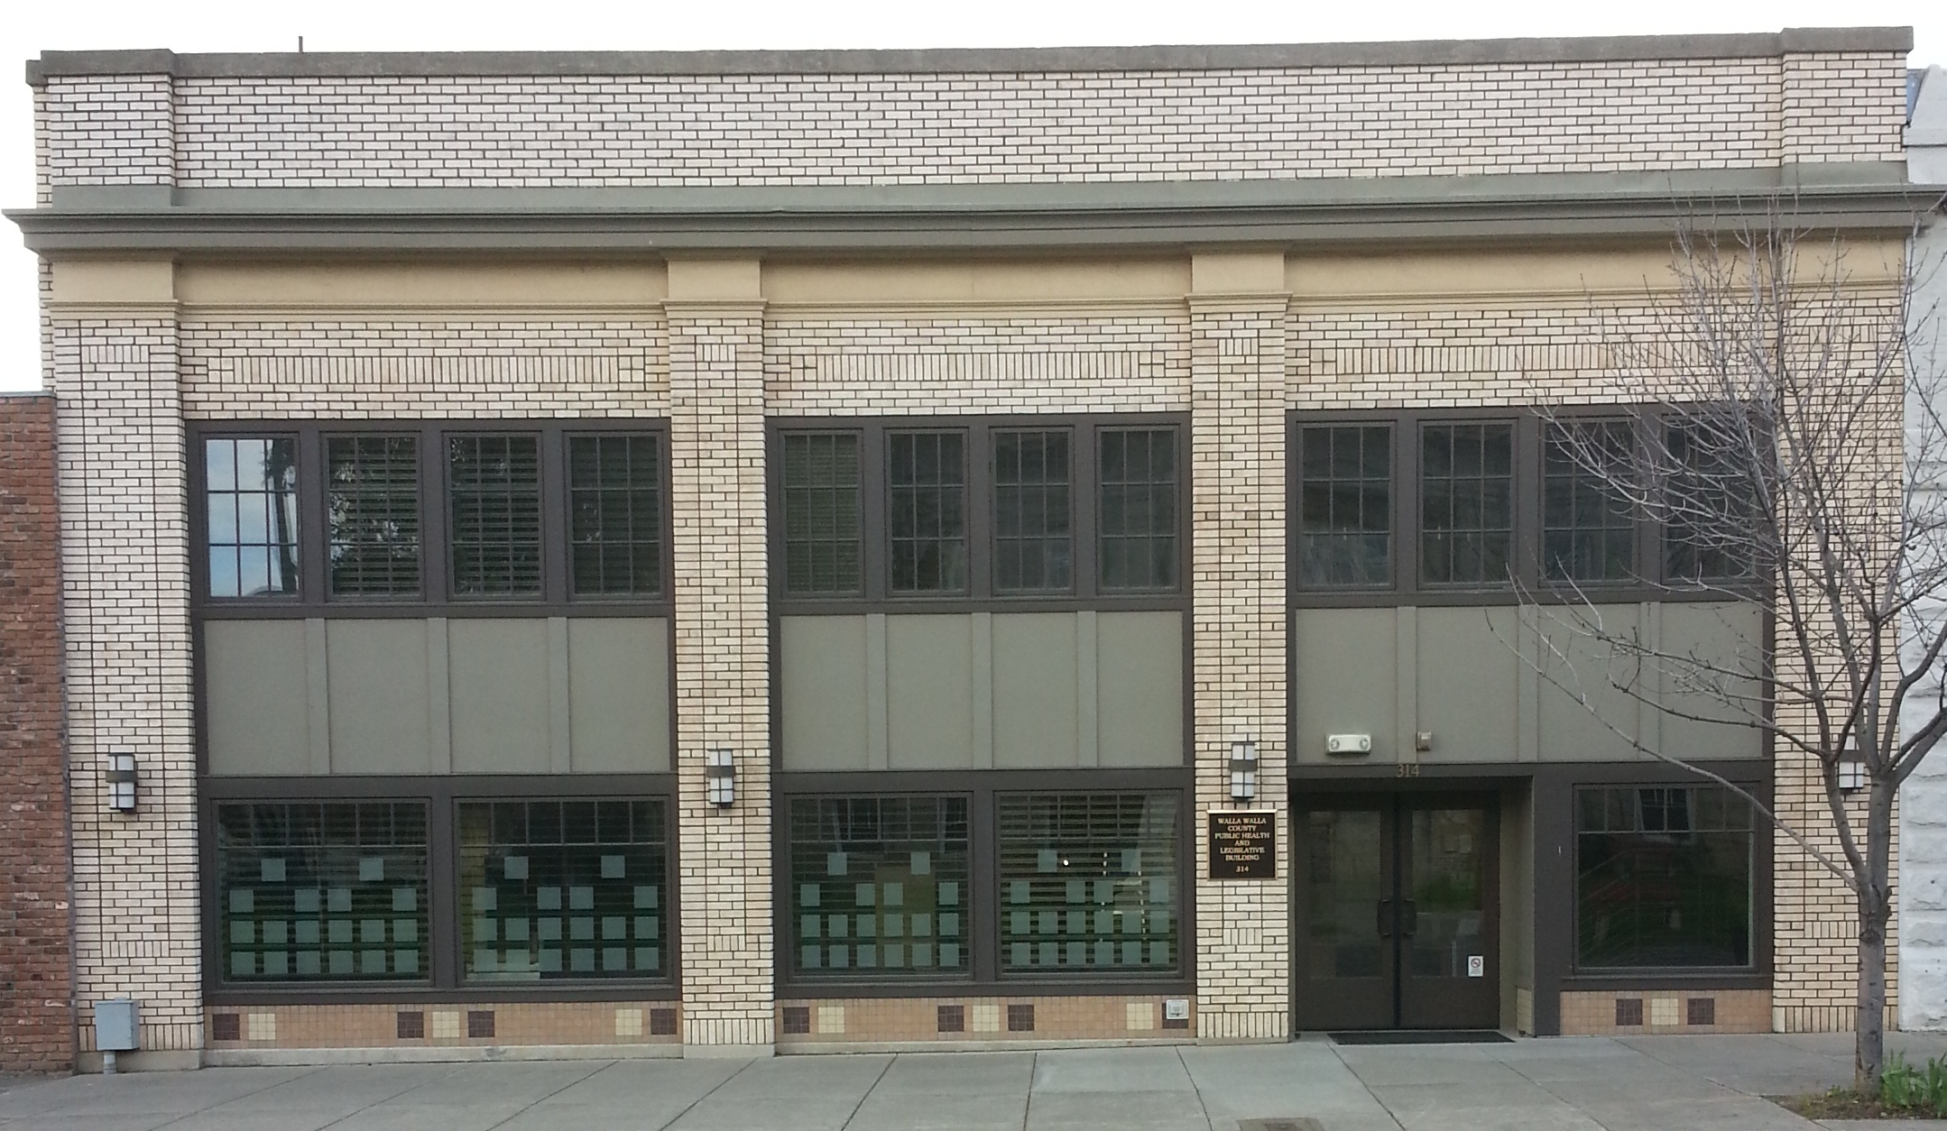

Slide 15
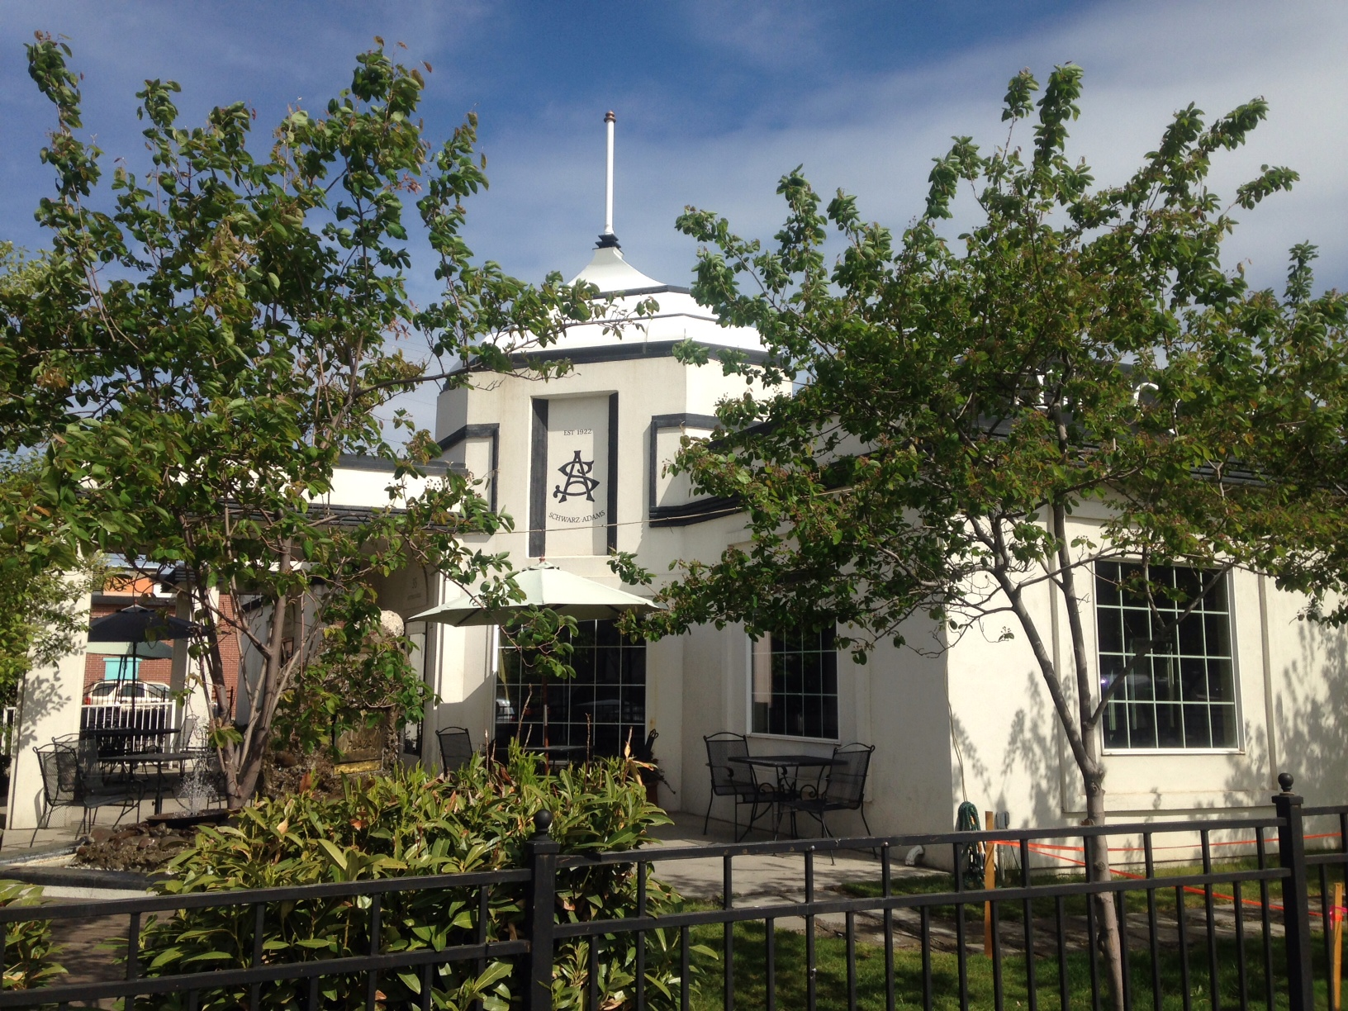
Marcy’s and
Schwarz Troyer Automotive
Owner:
Doug Schwarz and
the late Norm Adams
Contractor:
Dean Schwarz

Slide 16
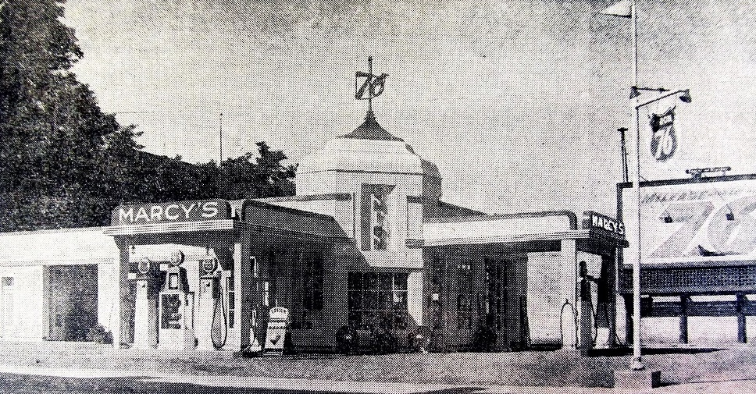

Slide 17
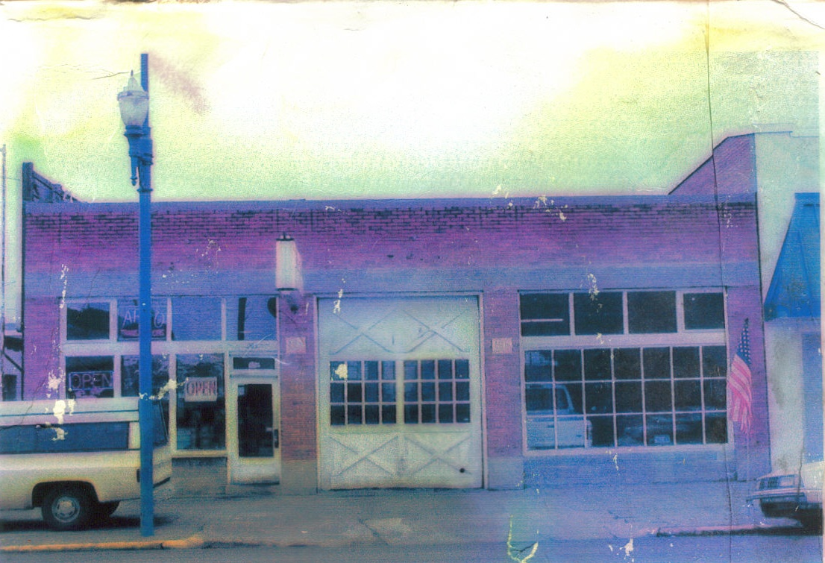
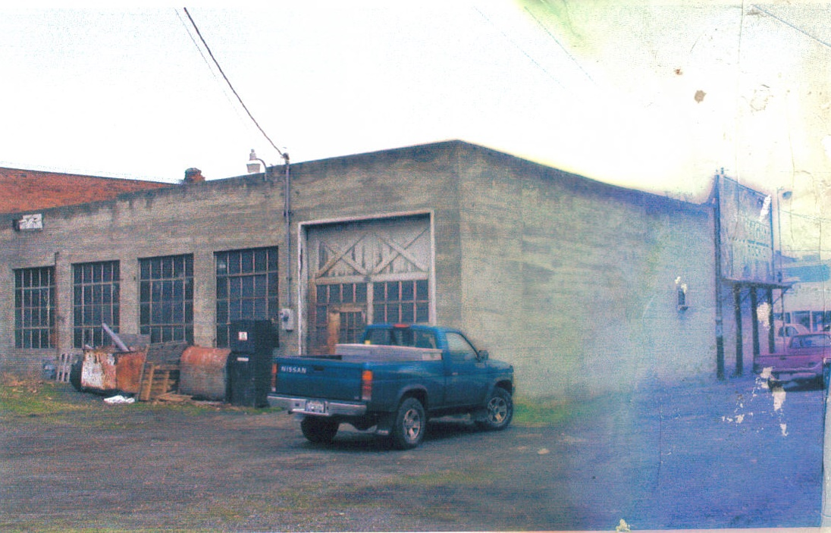

Slide 18
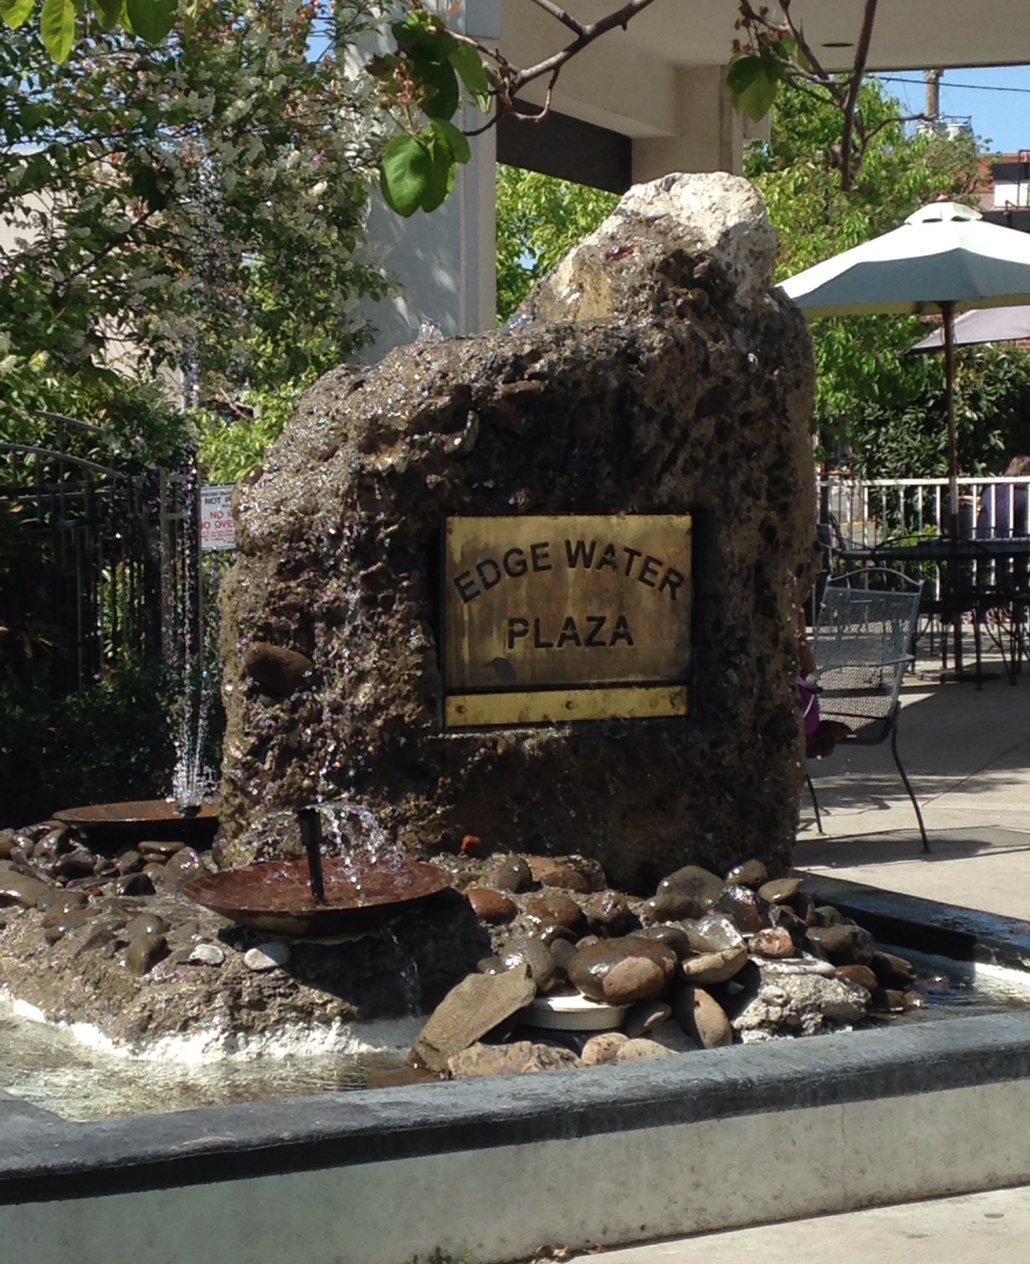
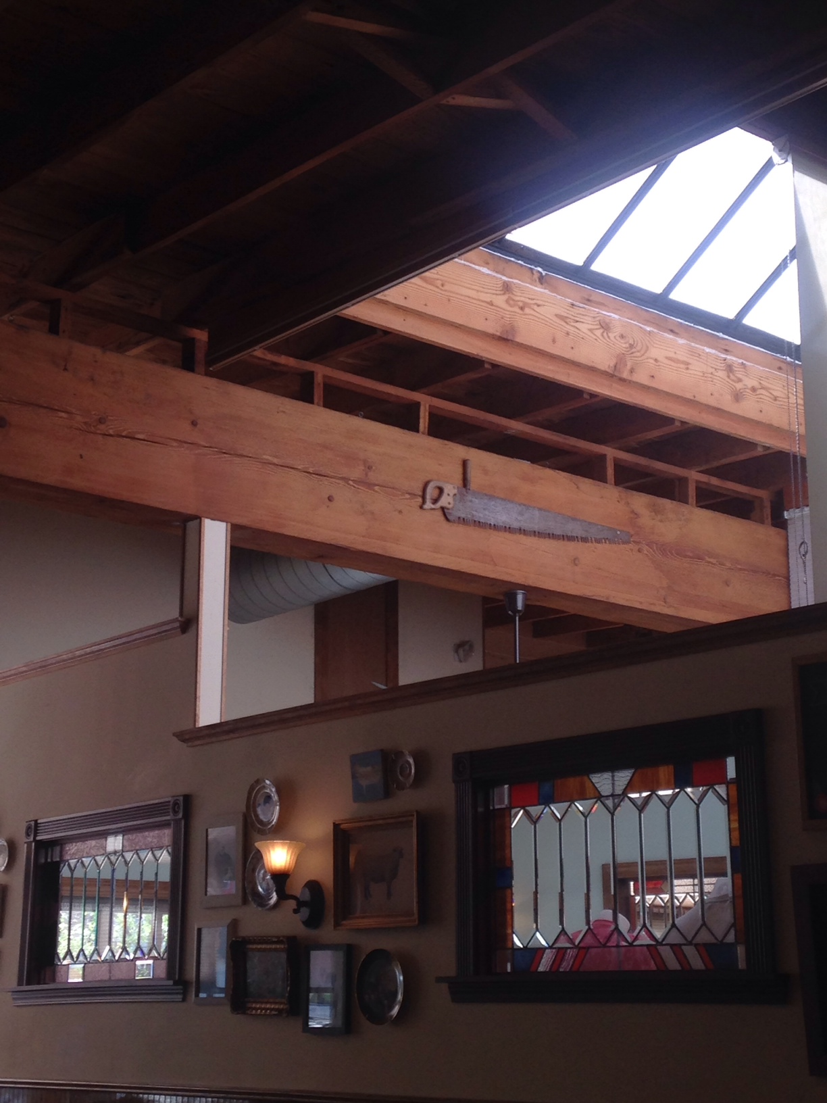

Slide 19
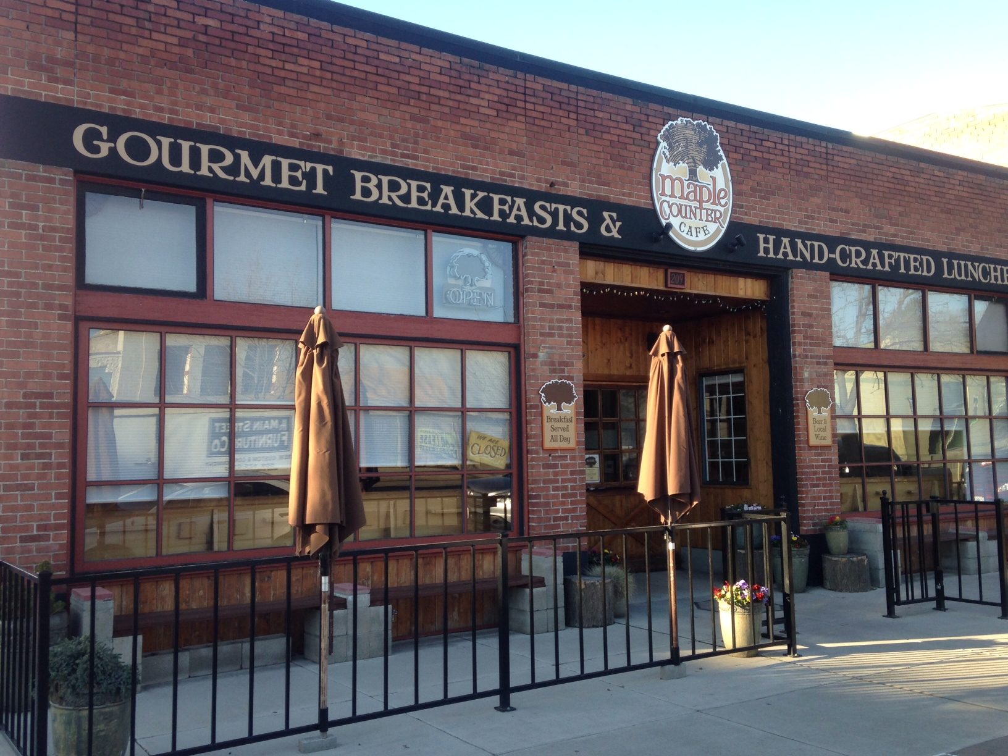

Slide 21
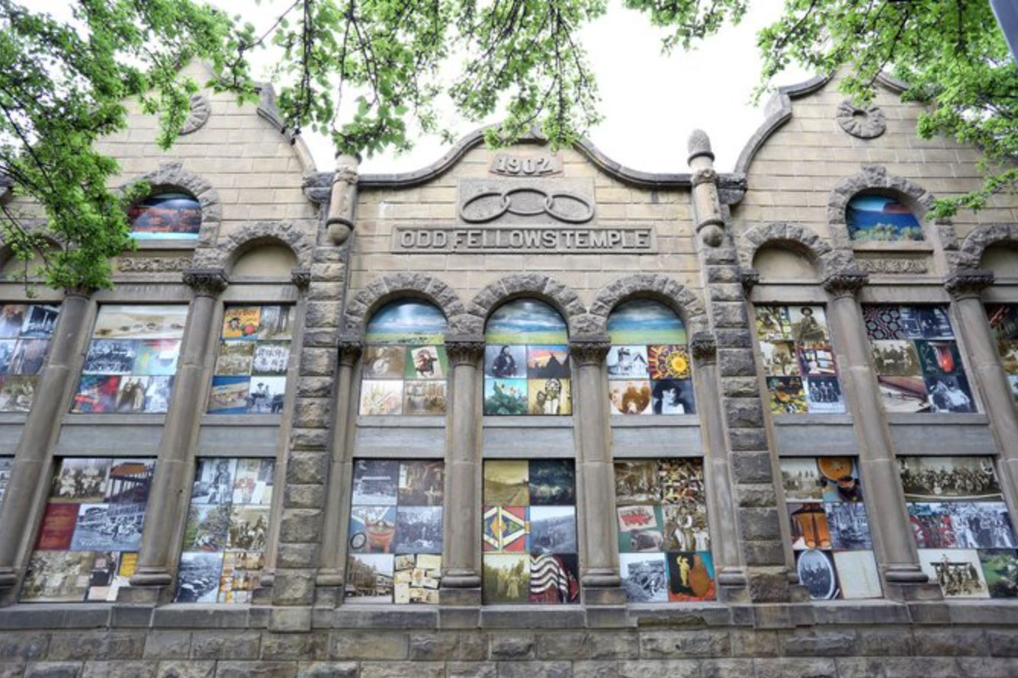
Windows
on the
Past
Owner:
City of Walla Walla
Heritage Park
Contractor:
ArtWalla
Jeana C. Garske,
Director
Rob Robinson,
President
Jeanne McMenemy,
Art Director

Slide 22
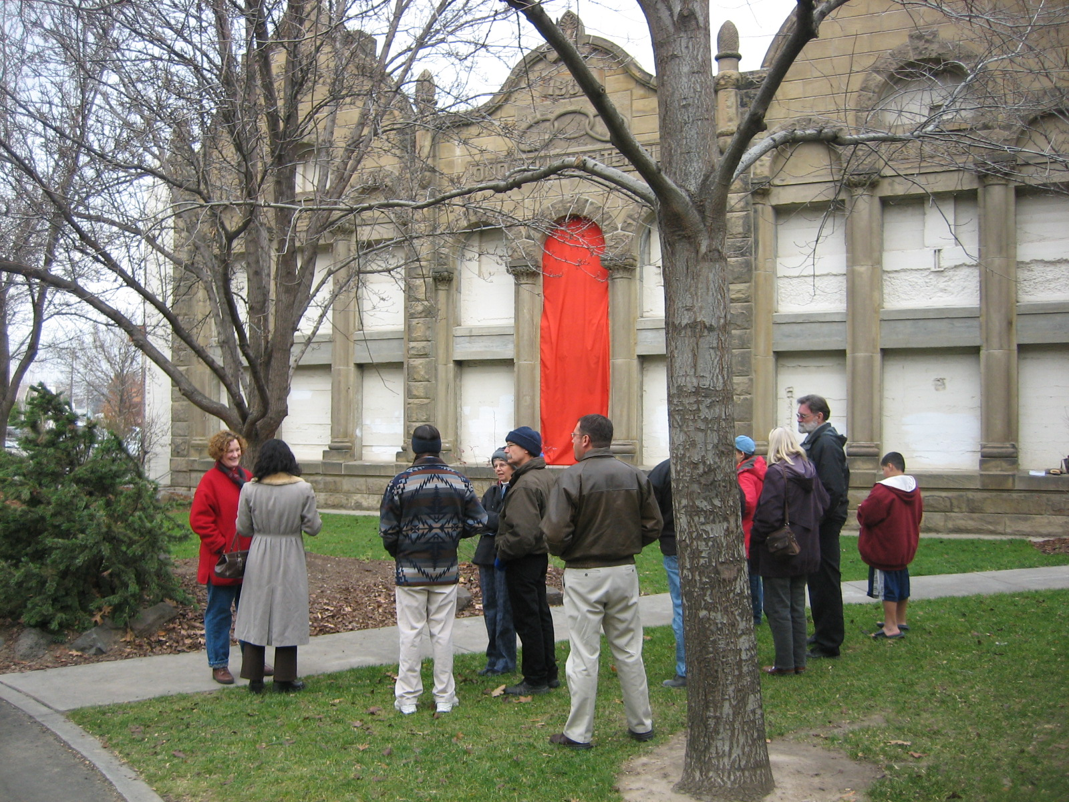

Slide 23
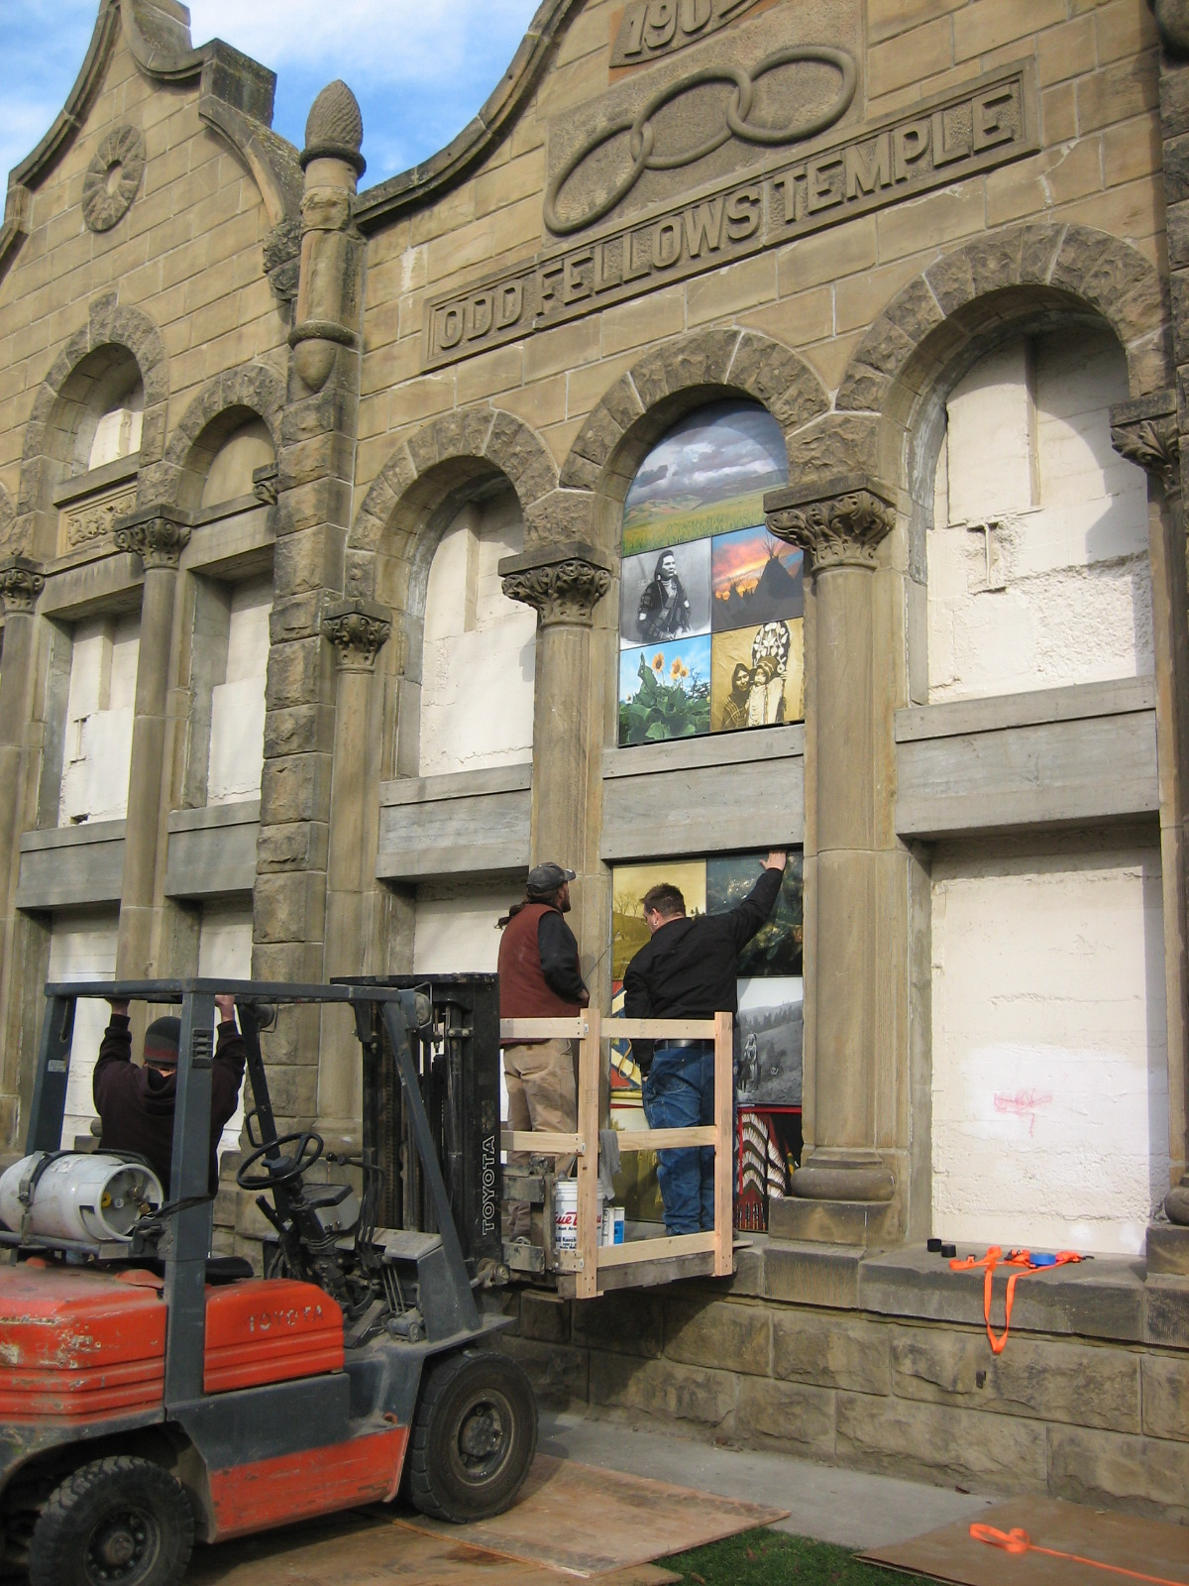

Slide 24
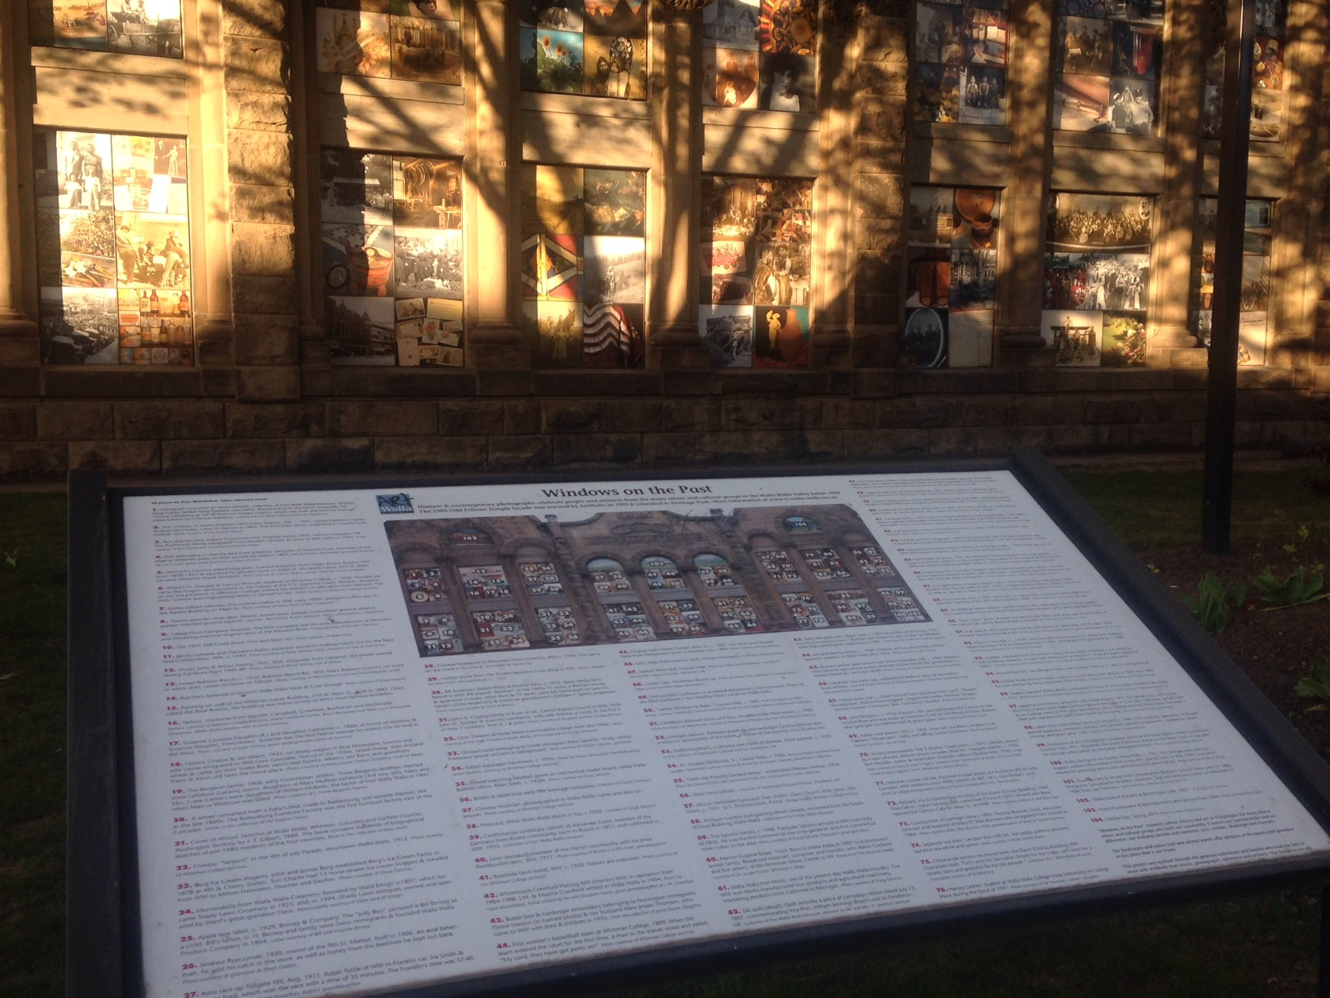

Slide 25
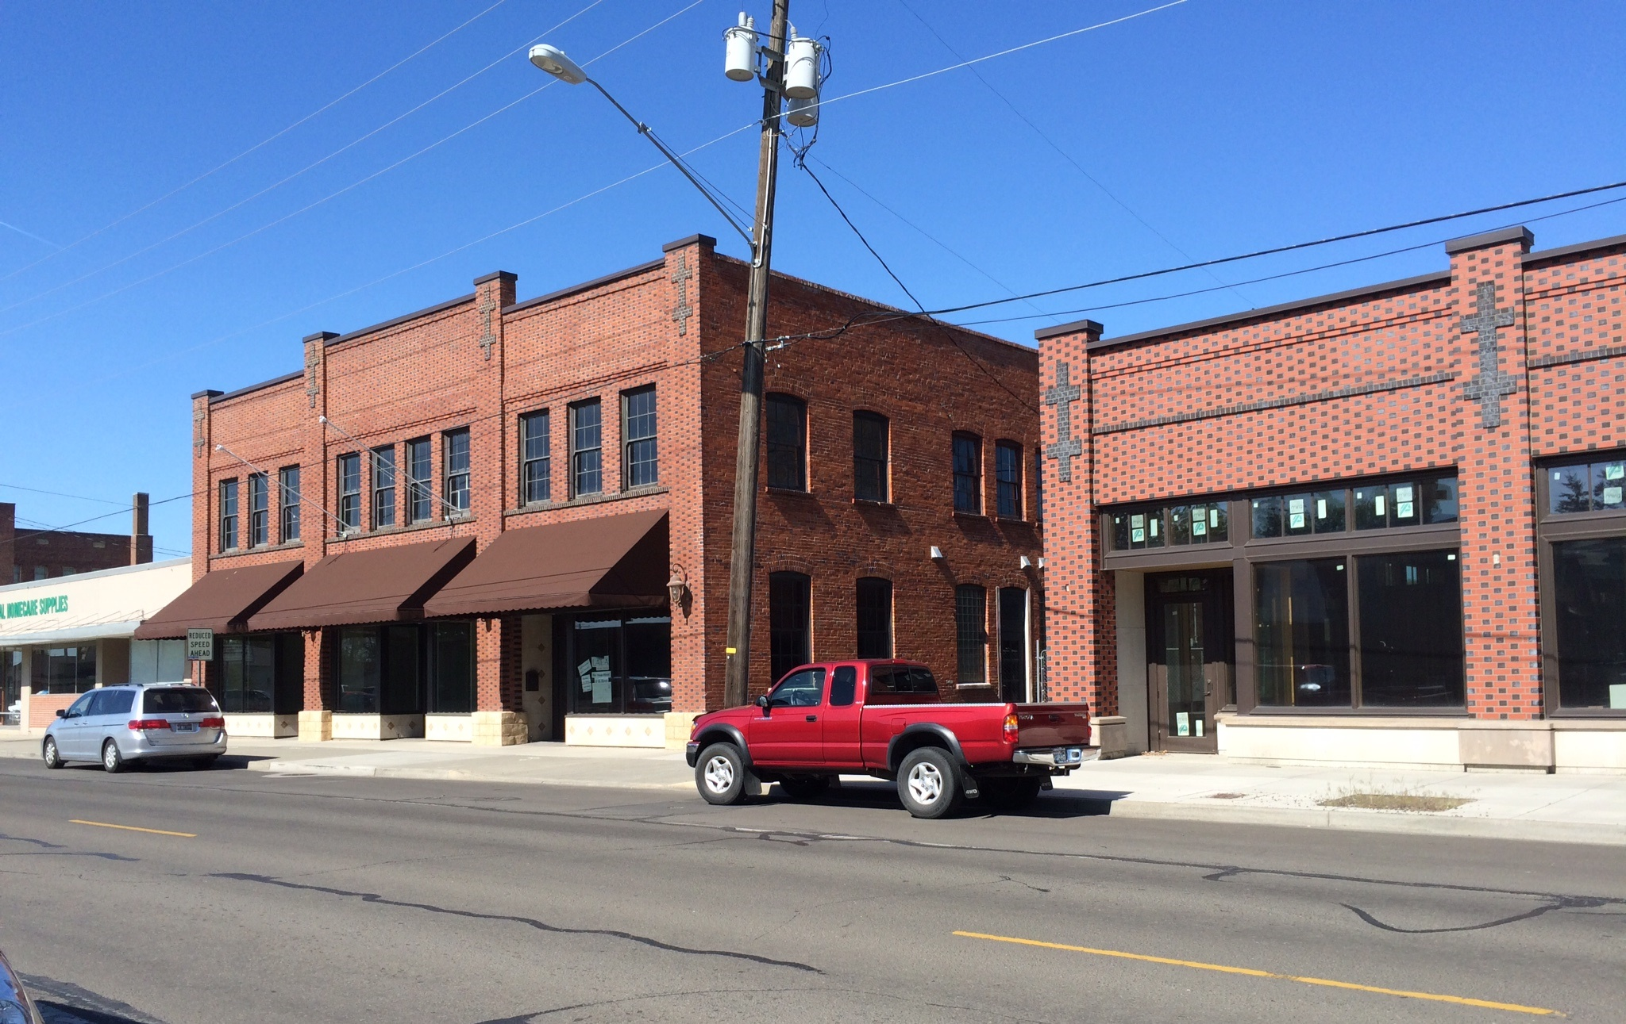
O’Rourke
Buildings
Owner:
WRO Enterprises
(Nibler Family)
Architect:
Stantec
Contractor:
Allen Kettleson

Slide 26
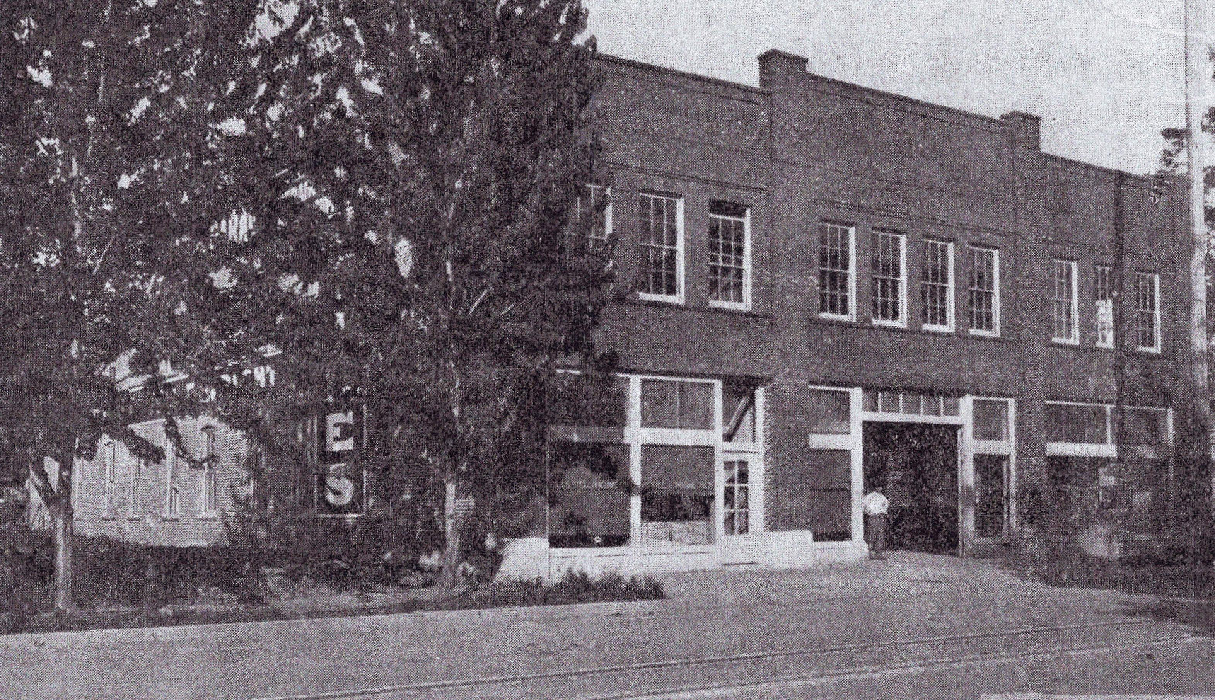

Slide 27
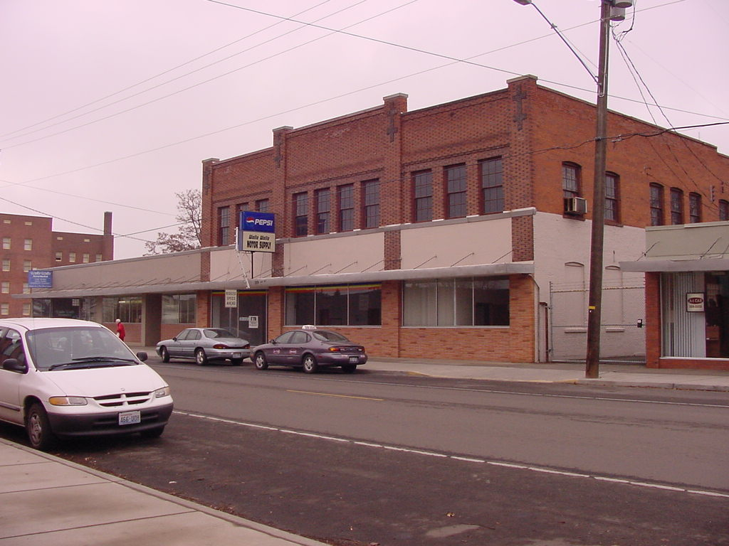

Slide 28
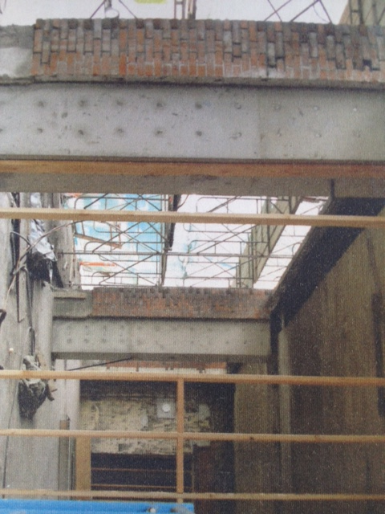
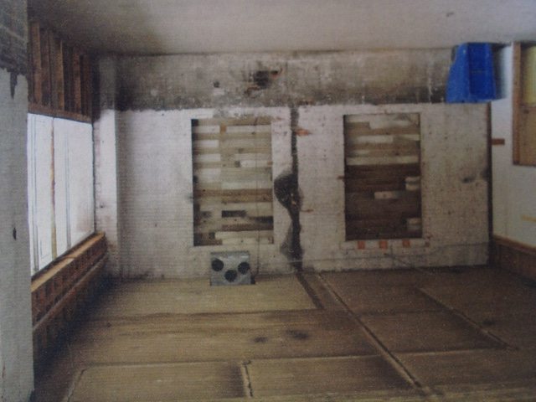
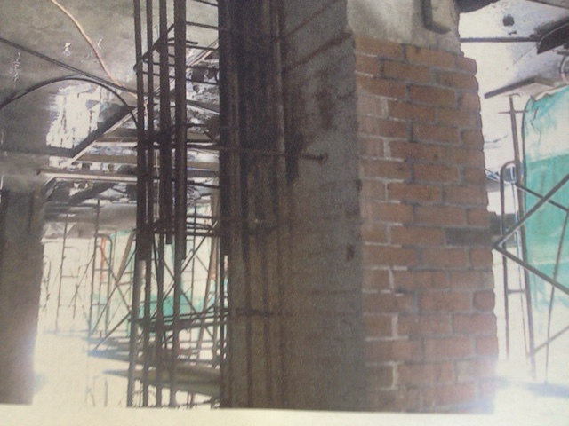
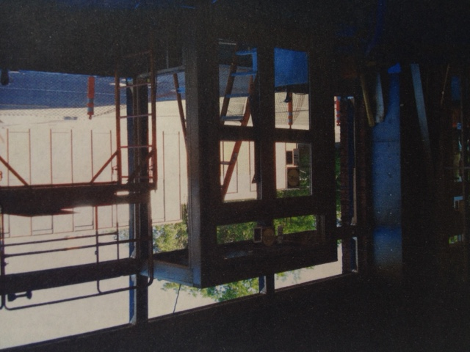

Slide 29
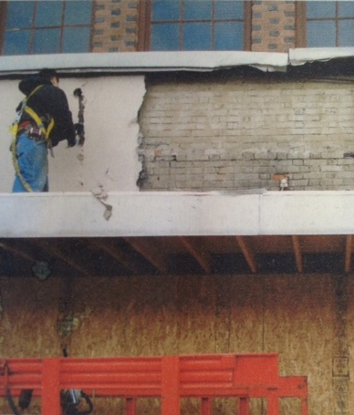
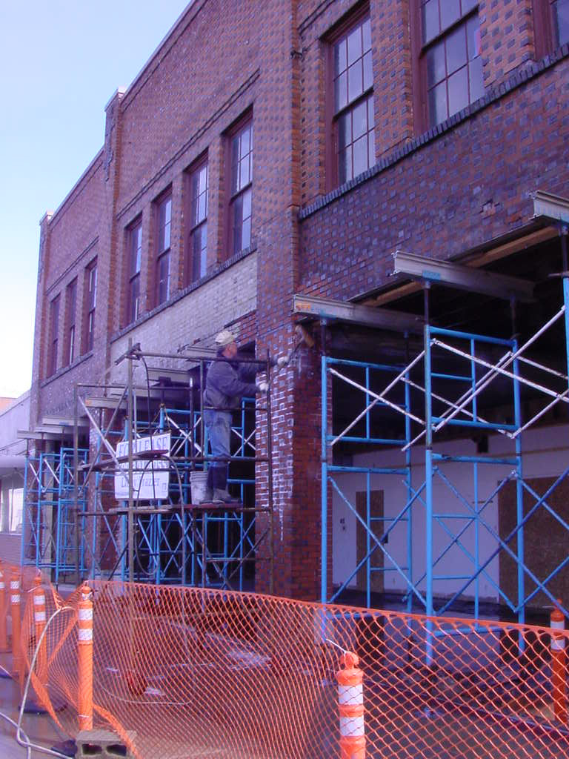

Slide 30
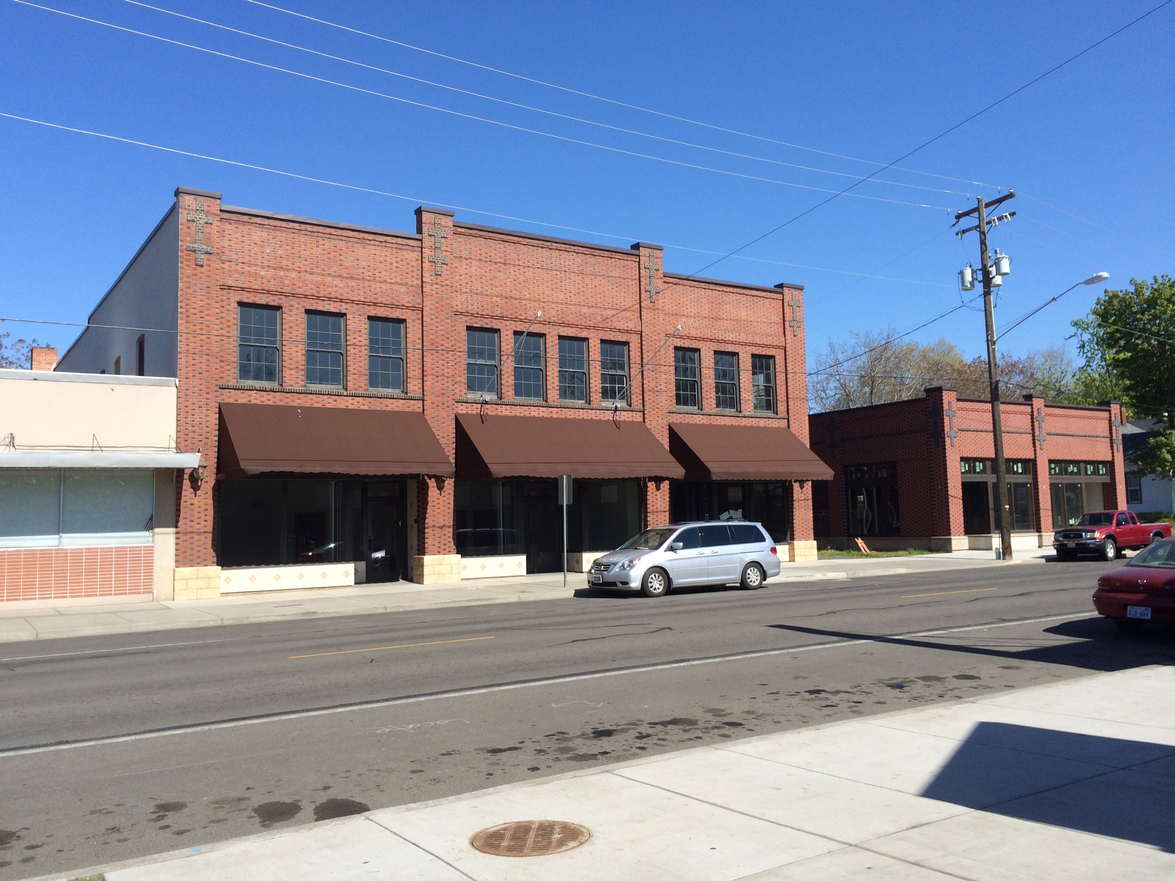

Slide 31
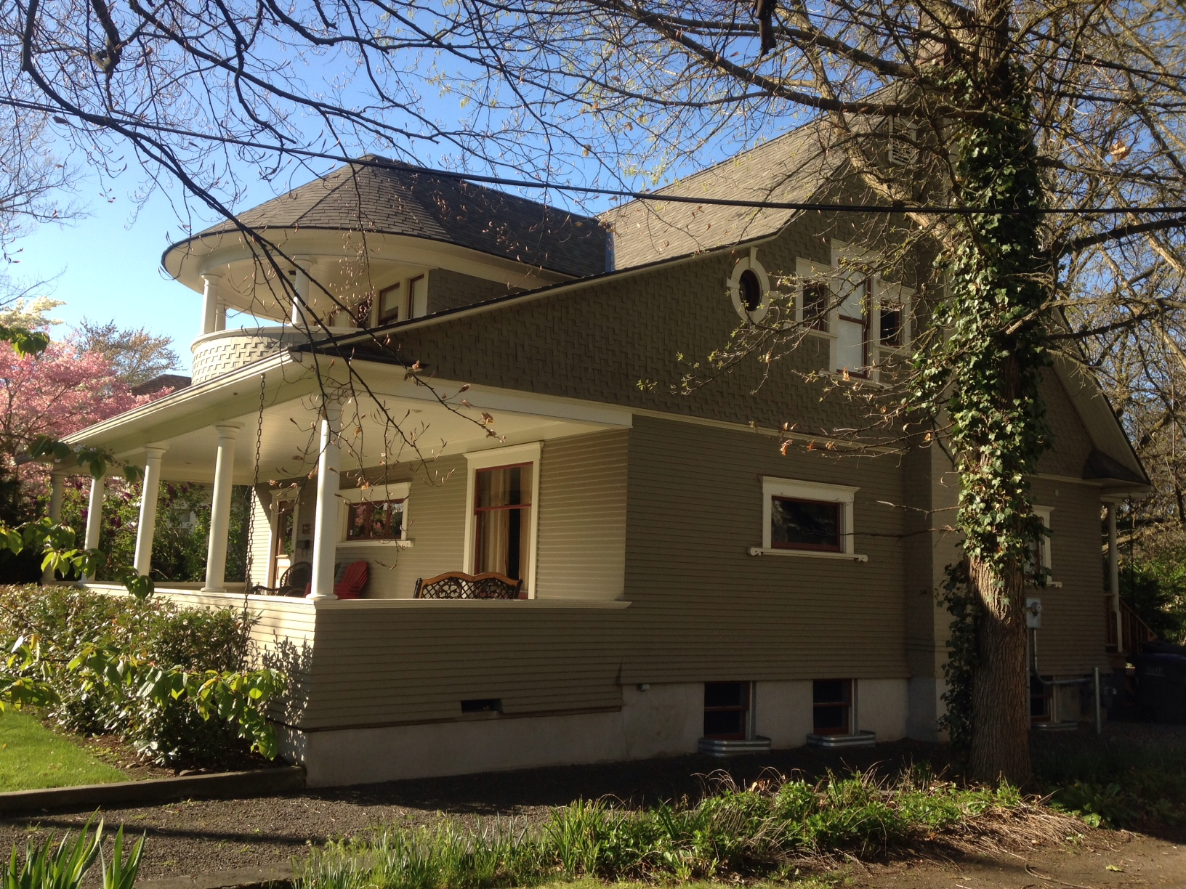
366 S. Palouse
Current Owner:
Mark McNeilly
Owner-Contractor:
Jim Herbert and
Gayle Seely

Slide 32
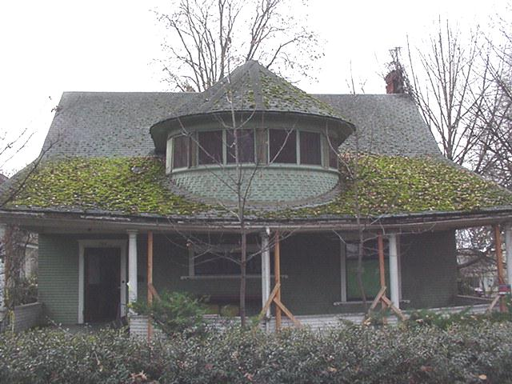

Slide 33
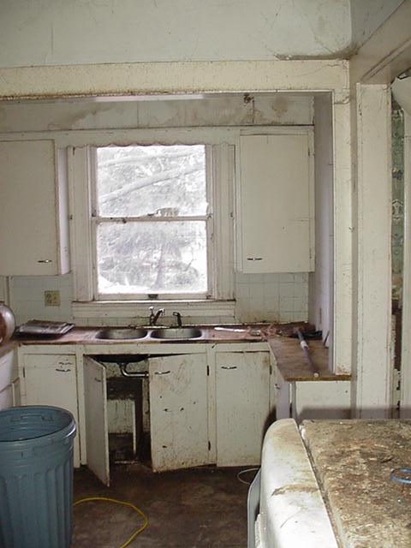
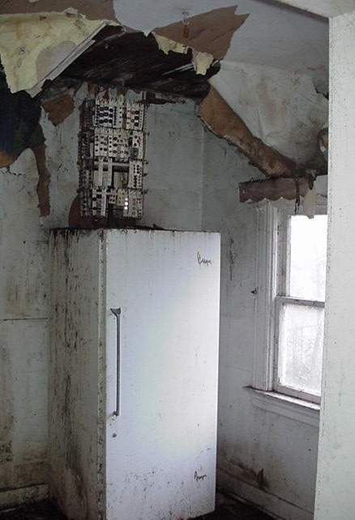

Slide 34
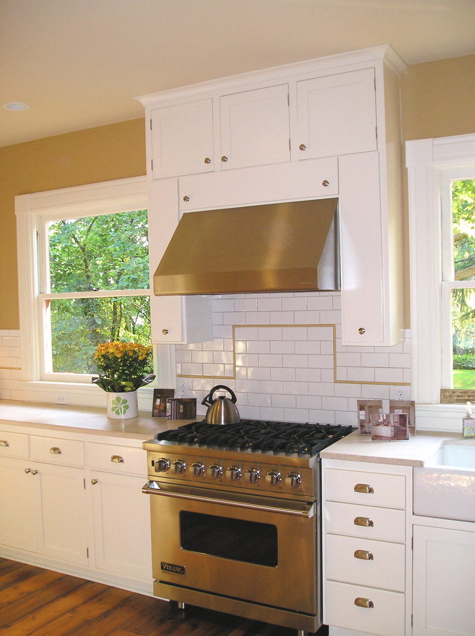
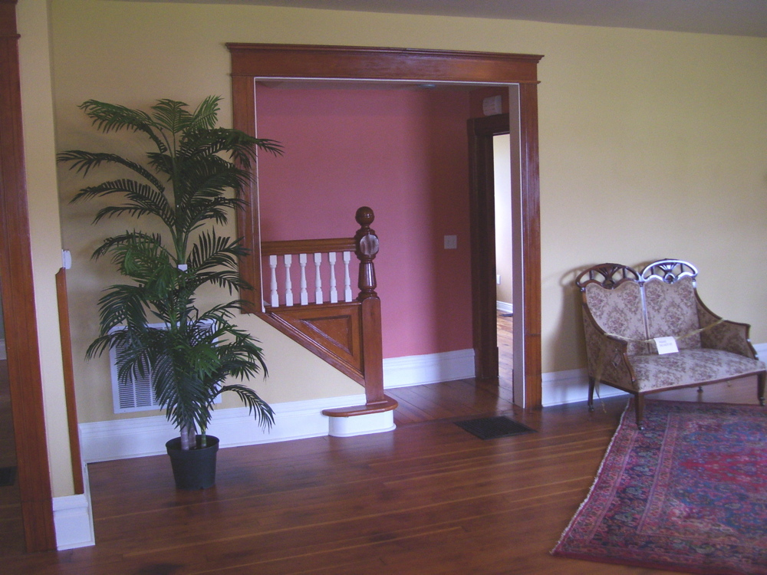

Slide 35
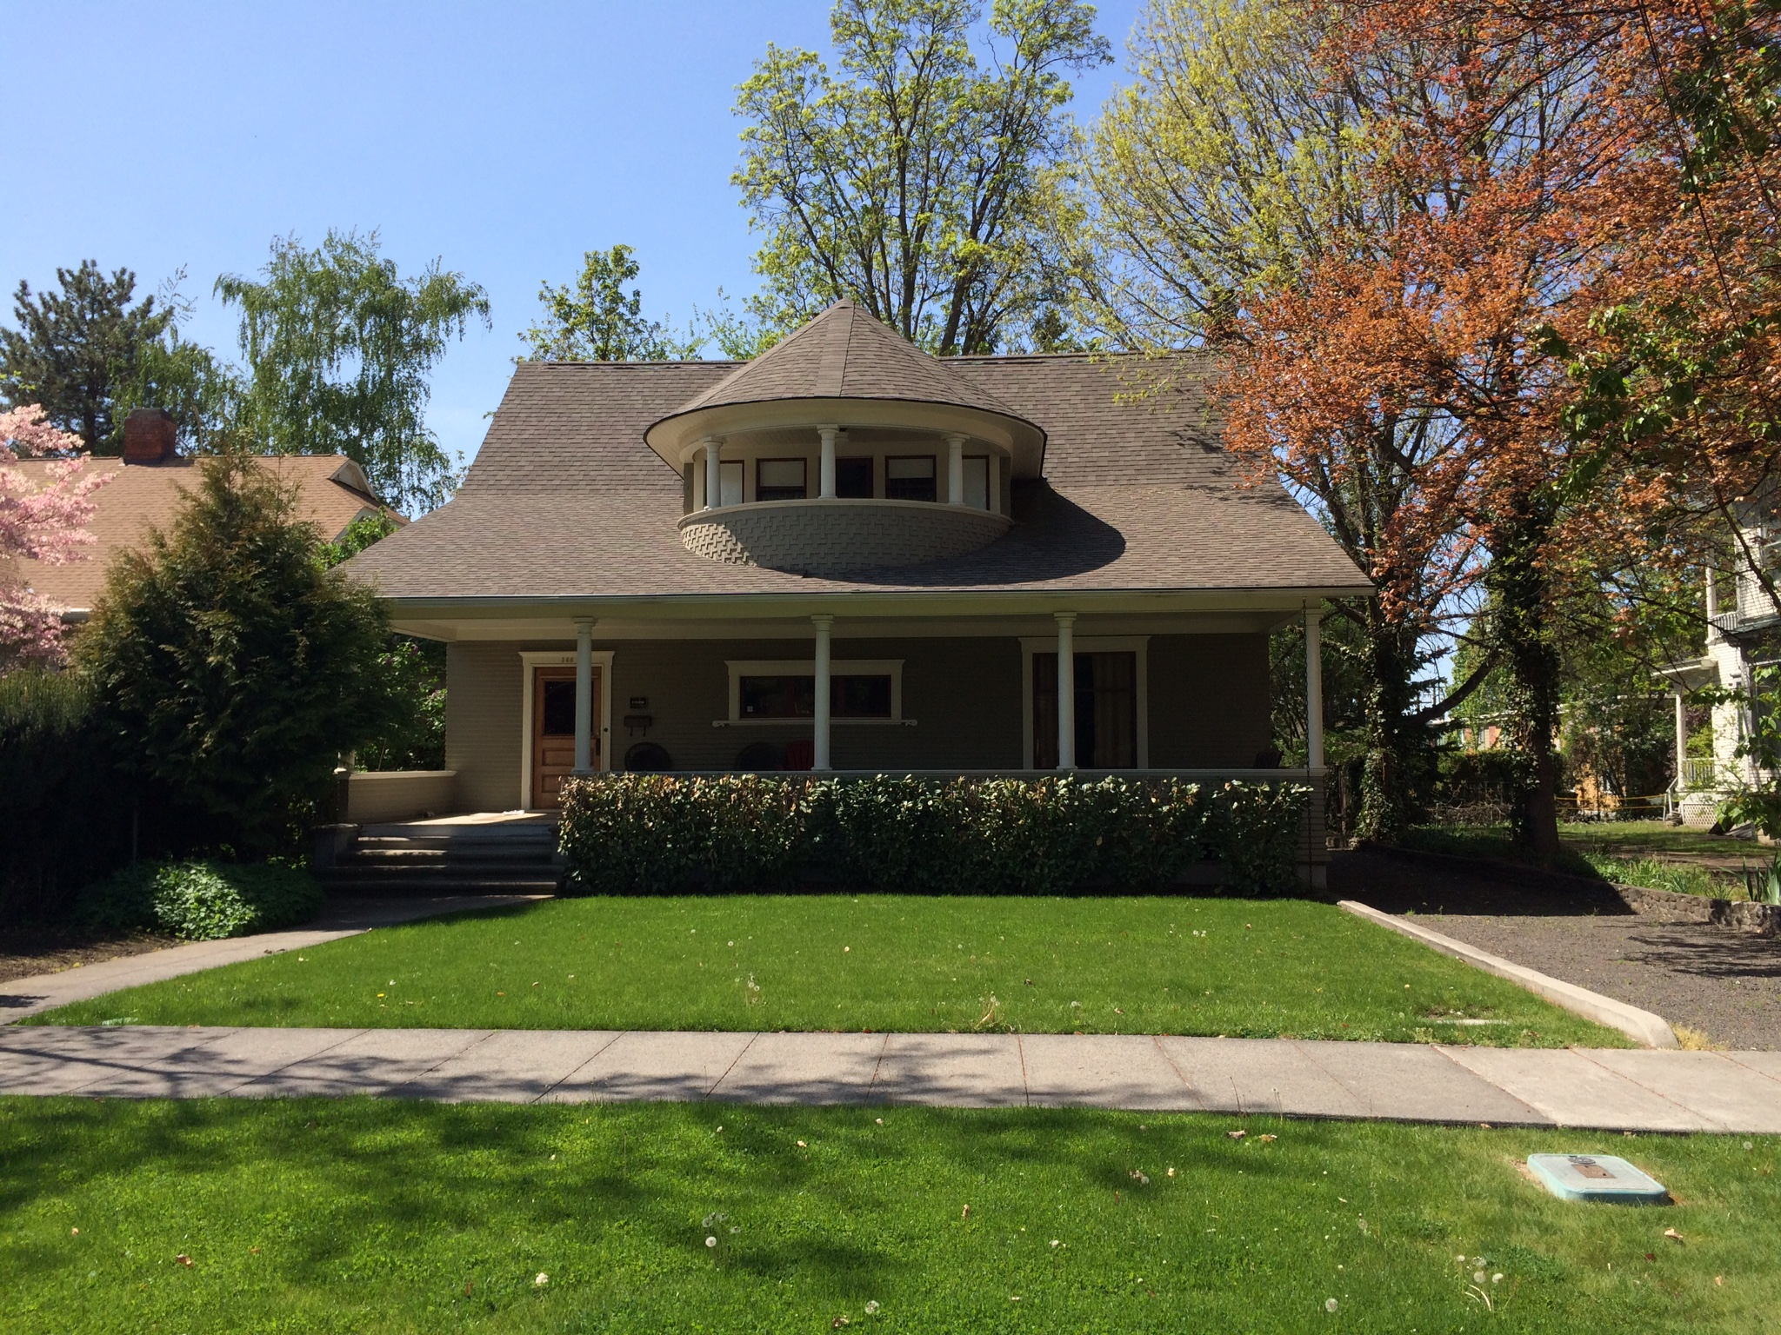

Slide 36
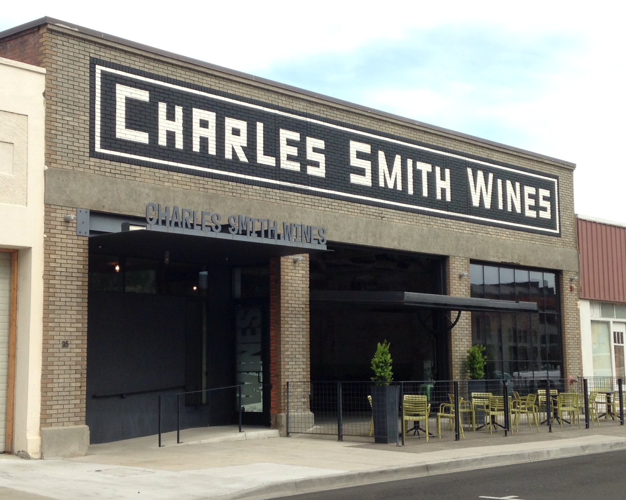
Charles K. Smith
Wines
Tasting Room
Owner:
K Brands LLC
Architect:
Olson Kundig
Contractor:
Schuchart
Construction

Slide 37
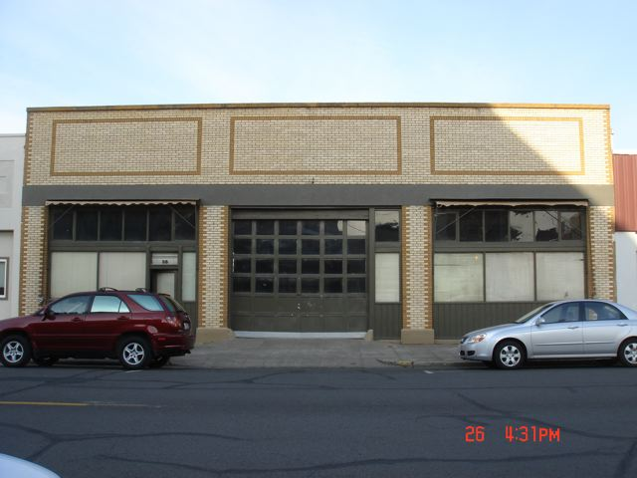

Slide 38
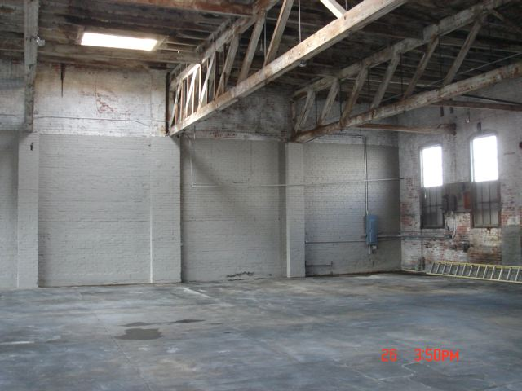
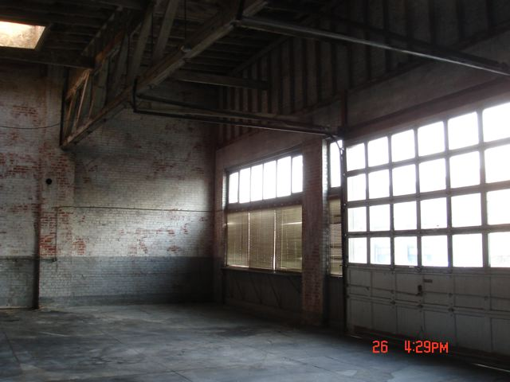

Slide 39
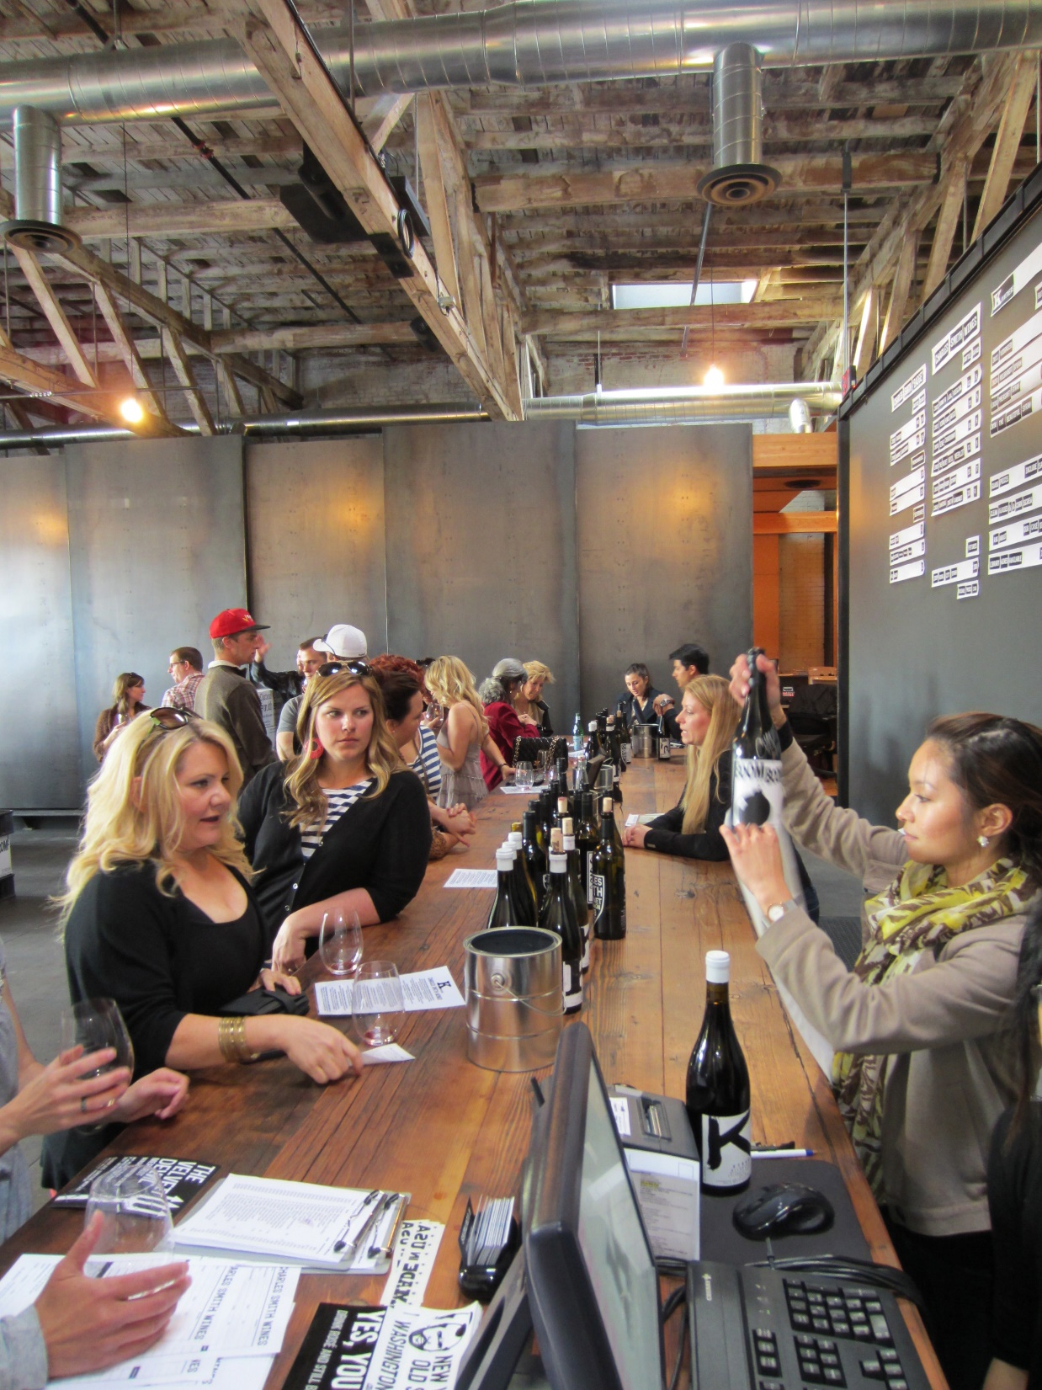
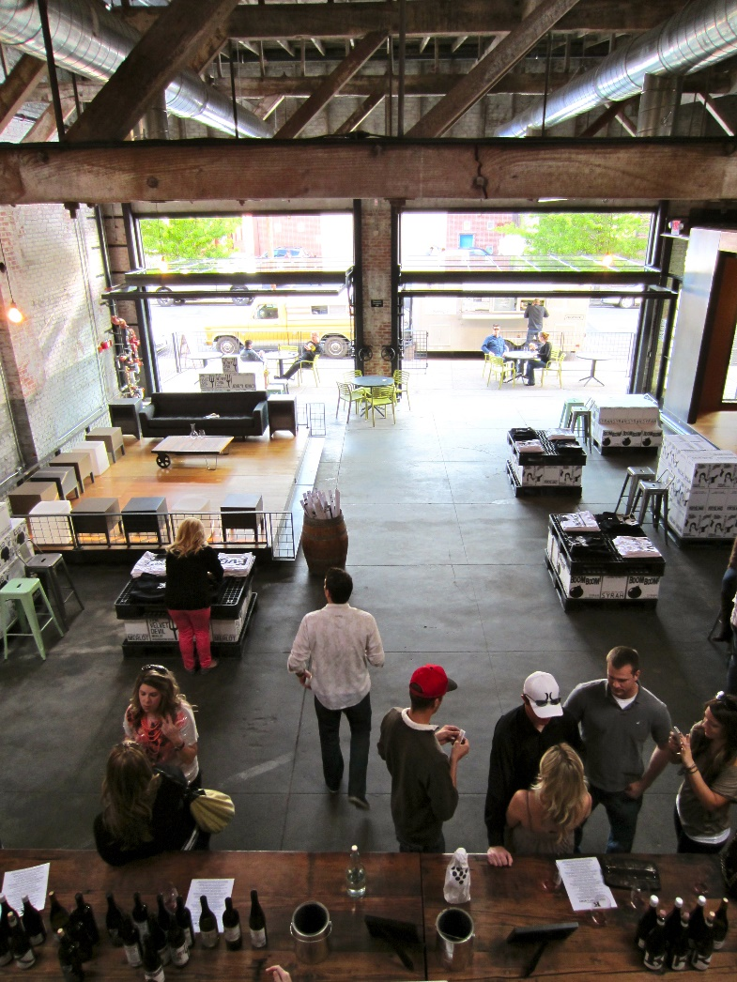

Slide 40
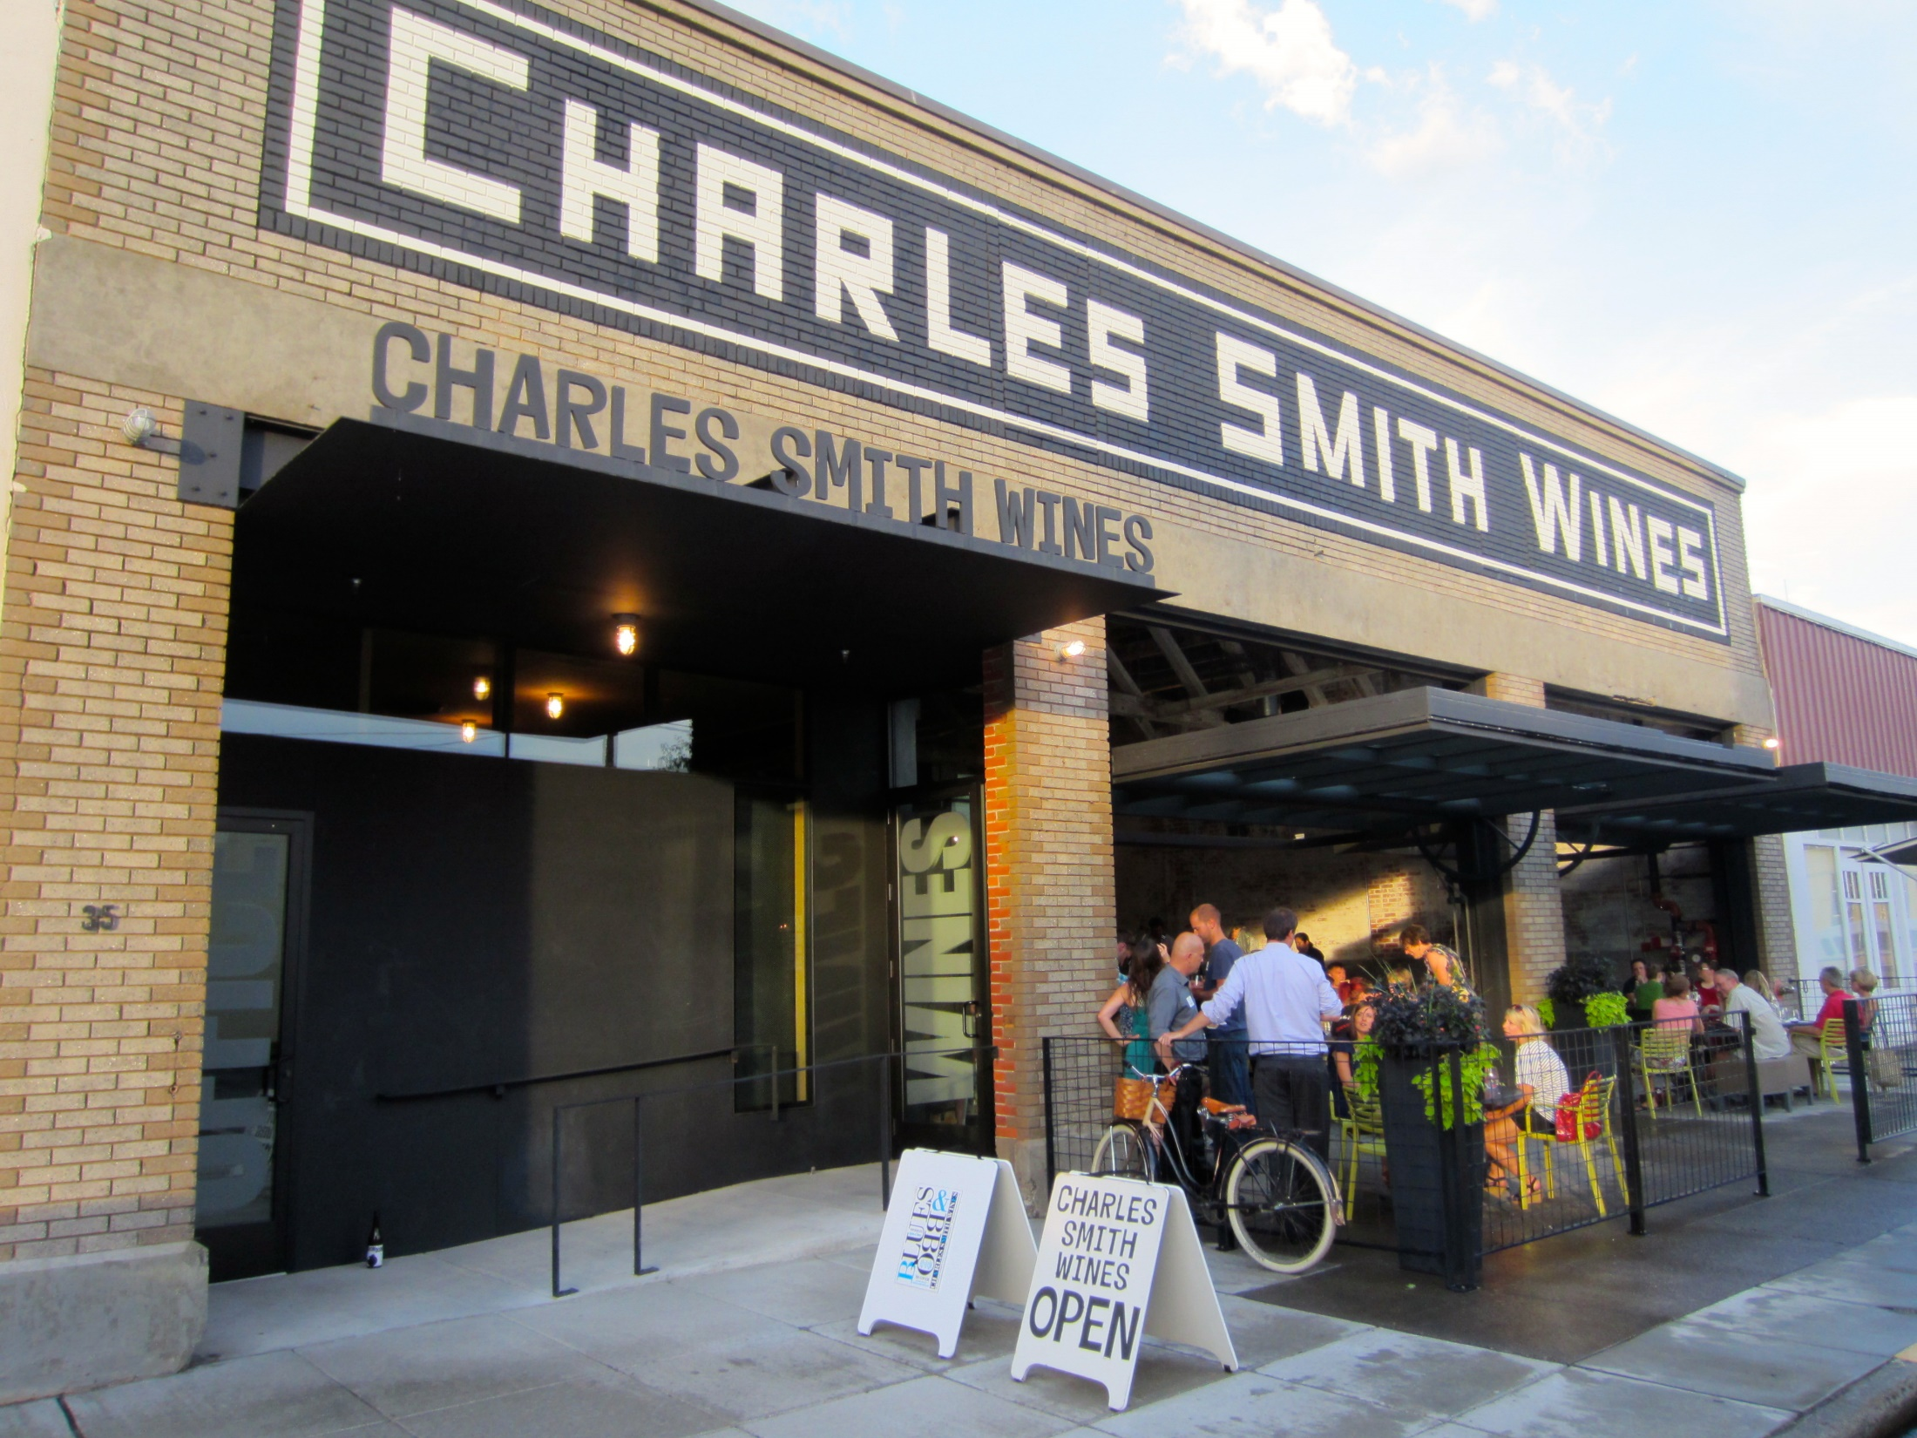

Slide 41
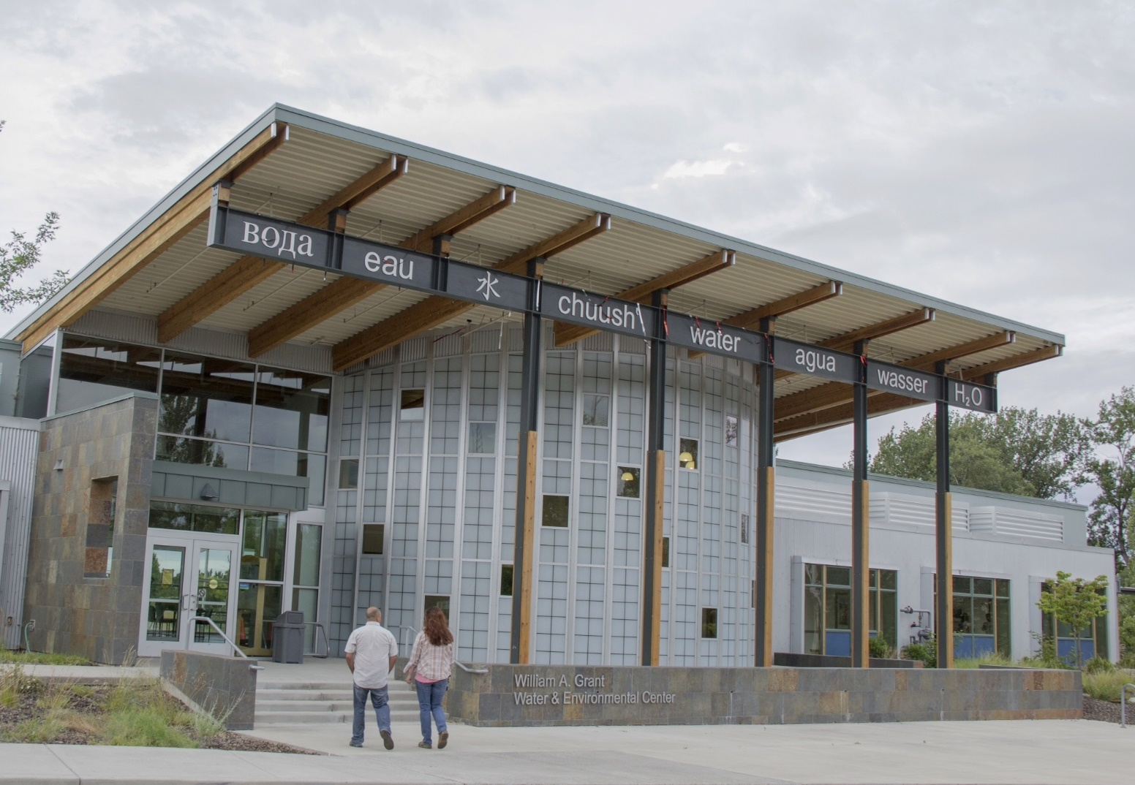
WWCC
Water and Environmental
Center
Owner:
Walla Walla
Community College
Steven VanAusdle, President
Architect:
ALSC Architects
Contractor:
Opp & Seibold
(Phase One)
Corp Inc
Construction
(Phase Two)

Slide 42
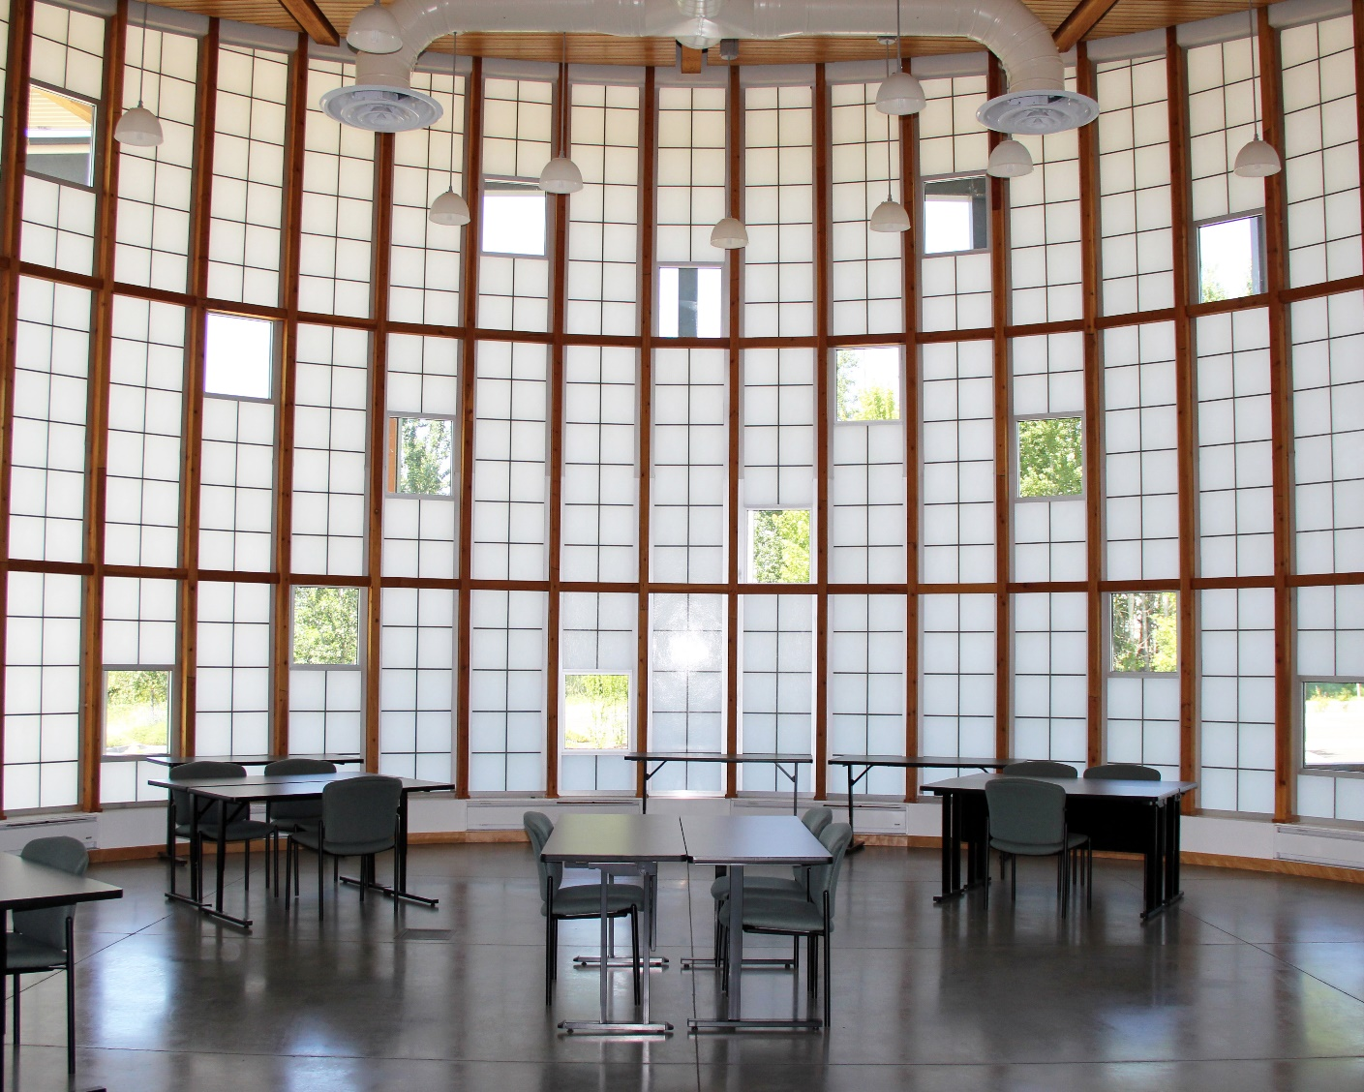


Slide 43



Slide 44


Slide 45

Whiteside
Building
Contributing Owners:
Ron & Dana Dunning,
Ron Williams,
Raffaele Exiana,
and Dennis Gisi
Contributing Architects:
Raffaele Exiana
and Stantec
Contributing
Contractors
Opp & Seibold
and Terry Brown

Slide 46


Slide 47


Slide 48


Slide 49



Slide 50



Slide 51


Slide 52

527 E. Sumach
Current Owner/Contractor:
Glenn & Kristine Hill
(landscaping
and external
finishing)
Owner/Contractor:
Justin Gillen and
Elizabeth Sweeney
(building)

Slide 53


Slide 54


Slide 55


Slide 56


Slide 57

Walla Walla
Goodwill Store
Owner:
Goodwill Industries
of the Columbia
Architect:
Olson Kundig Architects
Contractor:
Jeff Moeller
Construction

Slide 58


Slide 59


Slide 60


Slide 61


Slide 62


Slide 63

Mordo McDonald Building
Owner:
Mari Danihel
129 Alder Property LLC
Contractor:
Jeff Moeller
Construction

Slide 64


Slide 65


Slide 66


Slide 67


Slide 68


Slide 69

Baker Boyer
National Bank
Owner:
Baker Boyer National Bank
Meagan Clubb, President
Architect:
Longwell and Trapp
Contractor:
Opp & Seibold

Slide 70


Slide 71


Slide 72


Slide 73

Pantorium
Building
Owner:
Jim and Brenda Harold
Architect:
Theron Smith
Contractors:
Walt and Mark Porter

Slide 74


Slide 75


Slide 76



Slide 77


Slide 78

Lariat
Gardens
Owner:
Walla Walla
Housing Authority
Architect:
Carlton Hart
Architecture
Contractor:
Opp & Seibold

Slide 79



Slide 80



Slide 81


Slide 82


Slide 83


Bygone
Walla Walla
Project
Joe Drazan
Curator

Slide 84


Slide 85


Slide 86


Slide 87
About Bygone Walla Walla
  The BYGONE WALLA WALLA Project is a local non-profit, non-commercial effort to build and share a visual history of Walla Walla.
  What began as a retirement project in 2006 now has about 9,000 images in just over 1,000 topical posts on the blog. A new post and photo are added almost every day. The blog has hundreds of followers daily with well over a quarter-million views since its inception.
  Bygone Walla Walla is a noncommercial effort to build a visual history of photos, maps, vintage ads, sketches, postcards and assorted memorabilia — just about anything that shows “the way it used to be around these parts.”
  WANTED! If you have old snapshots (pre-1990) of Walla Walla area places and events that you would like to share in this project, please contact Joe to get them scanned in: skippycat3@charter.net
  http://wallawalladrazanphotos.blogspot.com

Slide 88


WW-FREE,
Community
Solar
Frederic Liebrand
Director

Slide 89


Slide 90


Slide 91


Slide 92
About WW-FREE
WW-FREE is a Washington state non-profit organization that administrates community solar projects. Community solar projects are privately owned renewable energy systems placed on local government property that qualify for increased monetary production incentives from the state of Washington. WW-FREE charges no fees for our work. Our officers take no compensation and have volunteered their efforts. Our goals are:
To raise environmental efficiency in public buildings which lowers the cost for our local municipalities to operate (your tax bill);
To raise money for scholarship endowments dedicated to lowering the cost for local children to go to college;
To enrich our community by investing and keeping money locally that otherwise would flow out of our area; and finally
To foster job training in tomorrow’s energy and building technologies for our children.
To do this, we will operate a community solar project on your behalf. Your money will go to buy solar panels and inverters that turn sunlight into electrical power to be used by your local government. You will retain ownership of that equipment, and have a right to it or its fair value at the end of the project. In the meantime, you also will also have right to the Washington State production incentives for renewable energy, and to federal incentives for installing renewable energy.
http://ww-free.com/

Slide 93





The
Sherwood
Trust
Jock Edwards
Ex. Director
Jock Edwards
Executive Director

Slide 94
About The Sherwood Trust
  Founded as a private foundation in 1991 by Don and Virginia Sherwood, the singular focus of the Sherwood Trust is for the Walla Walla Valley to reflect the highest, sustainable quality of life for everyone. In pursuing that mission, the Trust has adopted a grantmaking approach that mirrors the Tupelo Model for Community Development by investing in:
  Human Development –supporting continuing education through its Learning Center for Nonprofit Organizations
  Leadership Development—sponsoring a community leadership program that enlists up to 25 participants each year
  Organizational Development—making grants designed to build the capacity of nonprofit organizations
  Economic Development—primarily funding capital projects related to economic development and community infrastructure
  Community Development—“Helping people to help themselves.” An increasing focus on advocacy and community convenings by funding supportive infrastructure for community coalitions that are grassroots, inclusive, and formed to address civic issues
  http://www.sherwoodtrust.org/

Slide 95

GESA
Power House
Theatre
Contributing Owners:
Harry Hosey & Judith Schulman, Dennis & Donna Ledford,
Mark & Patty Anderson,
and Ken & Ginger Harrison
Contributing Architects:
Jon Campbell & USKH
Contractor:
Allen Kettleson

Slide 96


Slide 97





Slide 98




Slide 99


Slide 100


Slide 101








Thank You
Desserts and food service items donated by:
John's Wheatland Bakery

Slide 102

Awards
for a
Decade
Welcome!
Thank You!

